Slide 1

Resilience/Adaptation Plan Updates
Update Scan as of
November 6th, 2019

Slide 2
Town Of Ajax
Worked with Durham Region and local Durham Municipalities on the Durham Community Climate Adaptation Plan
Council approved Climate Risk and Resilience Plan and Climate Risk and Resiliency Implementation Strategy.
Focus # 1: Emergency Preparedness and Response
Focus # 2: Natural Systems
Focus # 3: Stormwater, Flooding and Erosion

Slide 6
Town Of Ajax – Implementation Plan

Slide 7
Town Of Aurora
State of resiliency/adaptation planning (corporate and community Resiliency/Adaptation Plans):
Council has conditionally approved 2020 budget for the Aurora Climate Change Adaptation plan, pending the release of the York Region Climate Change Action Plan (approx.. March 2020). The Town’s plan will have a corporate infrastructure focus, though there will be some community level analysis. The Regional plan is likely to have a community-level adaptation plan that can be incorporated into the Town’s Official Plan.
Top priority actions that have been/will be advancing: putting together the RFP sometime in the spring 2020, once the Regional plan is released. From that analysis, we will be able to identify top priorities.
Identifying needs to support municipal efforts: funding for adaptation plans/ implementation

Slide 8
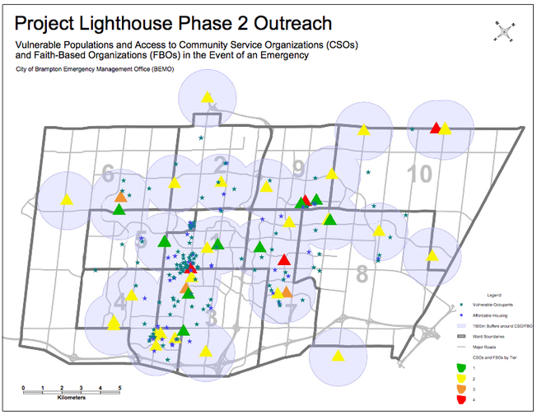
City of Brampton
Lighthouse Project: Working with faith based groups to serve as Resilience Hubs.
Getting uptake in Hamilton, Oakville, Burlington and Toronto
Link to Webinar on Brampton Project
Webinar to share an update on the transfer and implementation of this project is on the to do list.

Slide 9
City of Burlington
Directed by Council have a Plan for their review by Q1 2021
Stormwater & Climate Change Integration
Flood Reports and Studies
Stormwater Management Projects
Homeowner Outreach on Flood Prevention (in partnership with Intact Centre)
Advancing Resilience Hubs through BurlingtonReady (being led by Fire Department)
Accepted into Compact of Mayor Showcase Cities Collaborative (peer to peer mentoring)

Slide 10
Town of Caledon
Corporate and Community Climate Adaptation Plan in Development (update to mitigation plan and bringing in an adaptation focus as well).
Timeline of going to Council in Q4 of 2020

Slide 11
Town of Clarington
Worked with Durham Region and local Durham Municipalities on the Durham Community Climate Adaptation Plan
In July 2018 council mandate to establish an Inter-departmental Climate Change Working Group; Terms of Reference developed; focused on actions on within municipal control. Workshops with ICCWG for a climate change risk assessment
The ICCWG has partnered with University of Toronto to research the challenges and successes that municipalities face when implementing climate action plans
Hired a Climate Change Response Coordinator in May 2019
Establishment of the Rural Southern Ontario Climate Change (RSOCC) Community of Practice to share knowledge, resources and best practices with local rural municipalities on how to adapt to and mitigate climate change
Participation in the Durham Region Natural Environment Climate Change Collaborative (NECCC) to update regional climate projections and represent Clarington on matters related to climate change at a Regional level

Slide 12
Durham Region
Durham Region Climate Adaptation Plan (developed in conjunction with local municipalities)
Durham Region Agriculture Sector Climate Adaptation Strategy
Urban Heat Island: Keeping Our Cool report
Durham Region Future Climate Study Executive Summary or the full report in Volume 1 and Volume 2
Resilient House Standard
Bringing Climate Change into Official Plan
Update region-wide climate change projections to provide a consistent data layer for all municipalities in the Region and will be use to: Identify vulnerable areas and potential adaptation restoration sites; informing the Region’s Comprehensive Review, Watershed Plan; and supporting the implementation of plan actions and objectives.

Slide 13
City of Guelph
Adaptation/Resilience Plan in Development

Slide 14
Halton Region
Adaptation Plan in Development

Slide 15
Town of Halton Hills
Adaptation Plan in Development

Slide 16
City of Hamilton
Using ICLEI’s BARC process; got to Milestone 2 then went back to community with a focus on vulnerable populations
Had to delay plan development due to funding cuts affecting BACCO (Bay Area CC Office). City had to take on that role.
Risk & Vulnerability Assessment a high to do
Lessons learned: Do community consultation and bring in vulnerable communities from the outset so you don’t need to do the back-and-forth
Protect the time of the person who is tasked with doing the work
Do homework ahead of time connecting an organization’s mandate to climate issues: every group has had valuable insights about how climate breakdown is affecting their communities, even if at first they thought they would have nothing to say, but it did need some advance prep to guide the conversation

Slide 17
Township of King
Adaptation Plan in development

Slide 18
City of London
Vulnerability Assessment of Infrastructure to Climate Change
Topics under Review
Thames River and flood impacts on infrastructure
Energy and Greenhouse Gas Emissions
Slope stability study
Emergency management preparations
Business continuity planning
Inter-disciplinary team from City and London agencies; will make recommendations to the City

Slide 19
City of Markham
Advancing energy resilience efforts through Municipal Energy Plan

Slide 20
City of Mississauga
Climate Adaptation Plan in development
Merging Mitigation and Adaptation Plan
City of Mississauga: The Economic Costs of Climate Change (link to presentation recording) (link to Report)
Mississauga Stormwater Plan and Fee
City of Mississauga: Green Development and Stormwater Fees (video of presentation)

Slide 21
Town of Newmarket
Update during webinar or post webinar

Slide 22
Town of Oakville
Town wrapping up the Community Energy Plan in the next few months, presenting to Council early in 2020
CEP will include resiliency and adaptation actions related to community energy projects.
Be Rain Ready, Stormwater Master Plan Phase 2 considered climate change throughout the development. Phase 2 assessed the performance of the existing stormwater system to identify opportunities to decrease flood risk, Phase 3 will develop and assess the funding strategies to implement the plan and is scheduled to commence shortly.
The town’s Climate Change Adaptation Strategy is slated for its 5 year review/update this year, once again using the BARC tool. We will be aligning this strategy closely with our Asset Management and Emergency Management plan developments as well as their risk and vulnerability assessments. The first Adaptation Plan focused on the Official Plan and the Planning Department.
The development and implementation of OakvilleReady program which uses faith based organizations as community hubs in time of extreme weather or fire. The town has 7 active hub locations and is working to keep them engaged through outreach and education efforts – we have hosted 7 launch events and have given over 15 presentations in the community about the OR program and personal preparedness. Hubs tend to be in southern Oakville due to higher flooding risks.
Accepted into Compact of Mayor Showcase Cities Collaborative (peer to peer mentoring) . This will allow Oakville to be able to take more of a community focus on the update to the Adaptation Plan.
The town is part of the Halton Climate Collective - a partnership of all Halton municipalities, Halton Region, the University of Waterloo, the Halton Environmental Network. This collective is mostly focused on mitigation but also has adaptation in its vision/mission statements.
Students developed solar chargers for resilience hubs and developed climate change escape room
Climate Change Primer
Climate Change Strategy
Community Outreach Efforts – ClimateXChange

Slide 23
Town of Oakville (cont…)
Top priority actions that have been advanced/will be advancing
Update to 2014 Climate Change Adaptation Strategy
Update Corporate Sustainability Policy to include climate change considerations
Aligning PCP and GCoM reduction targets
OakvilleReady program development – 2nd round of funding – program expansion
Experiences and lessons learned
Partnerships have been key to developing and advancing any of the above work
Partnering with non-profits has provided access to funding opportunities a municipality would not be eligible for
Issues/Challenges
So much work is being done, hard to focus and concentrate efforts
All municipalities are at different stages
All programs calculate or report things slightly differently
Identifying needs that would support municipal efforts
Identifying current funding opportunities available to municipalities

Slide 24
Town of Orangeville
Corporate Climate Change Adaptation Plan (CCCAP) is in development (working to integrate mitigation planning and initiatives where possible)
Hired Climate Change Coordinator in May 2019 and established inter-departmental climate change working group in June 2019
Council passed a Corporate Climate Change Adaptation Policy in September
Vulnerability and risk assessment in progress – will be complete Q4 2019 (one of two workshops complete)
Adaptation planning and community and stakeholder engagement will be focus areas in 2020
CCCAP to be completed and passed by Council in Q1 2021
GCoM Showcase Cities Pilot Project participant – using this opportunity to advance our mitigation efforts with goal completing corporate and community GHG inventories and reduction targets by Fall 2020

Slide 25
City of Oshawa
To be updated

Slide 26
Peel Region
Peel Climate Change Master Plan
Peel Climate Emergency and Endorsement of Master Plan
Top priority actions Phase 1 – Pace Setters - Expanding green infrastructure across asset portfolio through SOGR tender – based on GIOA
CVC: Cooksville Vulnerability Analysis (recording of presentation)
Green Infrastructure Opportunity Assessment (pdf presentation), (recording)
Peel Health Vulnerability Assessment (pdf of presentation) (video of presentation)
Climate Change Storytelling and Communication ex. Bring Your Kids to Work Week
Lessons learned/Issues/Challenges
Meeting folks where they are at and providing low carbon juice to those who need it
Identifying needs that would support municipal efforts
Work to explore the establishment of Low carbon and/or climate resiliency (policy) zones across the GTHA to activate market potential. At exploration stage…

Slide 27
City of Pickering
Passed through council the Durham Community Climate Adaptation Plan (still need to confirm)
To be updated

Slide 28
City of Richmond Hill
Corporate Climate Change Risk Assessment
Completed in 2018, Richmond Hill performed a high-level scan that assessed the risks to our municipal corporation from future climate scenarios and identified potential adaptation opportunities
  This risk assessment consisted of a series of inter-departmental workshops led by the OCC and coordinated by Richmond Hill’s Sustainability section
  Participants identified potential impacts to their division and possible interactions with other divisions
  A methodology to rank by risk and consequence was applied to verify and prioritize risk statements
Almost 700 risk statements were analyzed and scoped down to several categories for adaptation; Focusing on the top 3 categories would address 70% of the risks
Likelihood of Occurrence
Sum of Consequences
= Risk Ranking
X

Slide 29
City of Richmond Hill
Richmond Hill’s Climate Change Mandate
Approved by Council June 2018, this mandate addresses both adaptation and mitigation through two main initiatives:
  Climate Change Framework: An umbrella framework to identify municipal obligations and align priorities for mitigation and adaptation with corporate plans and programs
  Community Energy & Emissions Plan: a comprehensive study to look at our community’s energy consumption patterns and identify opportunities for conservation, efficiency and reducing GHG emissions; MEP funding received from Province of Ontario to complete this project

Slide 30
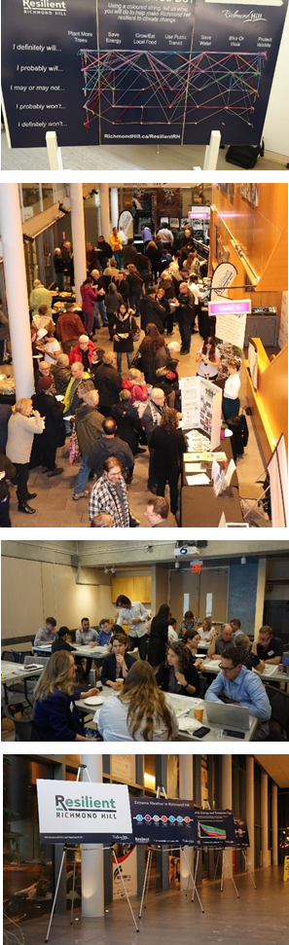
City of Richmond Hill
Resilient Richmond Hill – We are currently undertaking community engagement
and consultation for climate change awareness and the CEEP, which provides us
with insight into the community’s perception of mitigation and adaptation
and their understanding of climate change and action. Engagement tactics thus
far have included:
  Stakeholder advisory panels for both internal and external stakeholders.
  Activities at community events, including a community string art piece and a
  resilience map using ArcGIS Online’s crowdsource reporter.
  Passive displays leveraging our partners at the Richmond Hill Public Library,
  including education boards, a book display, and a dot-mocracy activity.
  Holding flagship event. On November 12th, we held a community event that included
  a film screening, a Q&A with the filmmaker, as well as engagement activities.
  This event was attended by 240 people.
  Online engagement (to be launched)

Slide 31
City of Toronto
Toronto Resilience Strategy
Climate Adaptation Strategy to Address Urban Flooding
Climate Change and Health Impacts and Adaptation
Transportation Vulnerability Assessment
6 PIEVC Assessments have been completed in Toronto
Climate Change Risk Management Policy
Toronto Climate Change Risk Assessment Tool
Climate Resilience Framework

Slide 32
City of Toronto
Resilience for High Rises will be a focus for Resilience Hubs
Working with CPA Canada (Guidance document for Carbon Related Carbon Disclosure) working with Montreal and Vancouver on this.
Incorporate into Financial Statements the costs of climate change.
Looking at Metrics for Resilience (KPIs)
Sustainable Financing Exploration (how to bring the private sector into Resilience actions)
Food vulnerability risk assessment
Need to rebuild internal champions due to some staff changes and limited budget allocations
Advancing climate lens processes and training

Slide 33
City of Toronto Resilient Strategy Actions

Slide 34
City of Vaughan
The Climate Adaptation and Resilience Framework will be a supporting study for the Official Plan Review (OPR). Timeframe around Q2 2020.
Stormwater risk and vulnerabilities analysis

Slide 35
Town of Whitby
Worked with Durham Region and local Durham Municipalities on the Durham Community Climate Adaptation Plan; passed by Whitby Council
Chair the Durham Region Natural Environment Climate Change Collaborative (NECCC)
Working with Durham Region to update climate study (ensemble climate model approach); will look at drought, snow cover, etc.
Undertaking a urban flood study to be completed in March 2020 will inform Climate Change Plan.
Will be doing a qualitative risk and vulnerability assessment but also a quantitative risk assessment will look at heat mapping & updated watershed planning, emergency management plan, escape route, natural systems.
There is an opportunity to transfer qualitative vulnerability assessments but will need a quantitative approach to prioritize interventions to reduce risks as risks cant all be addressed at once.
There are gaps in storm water systems; what storms to we build to? how do we incorporate climate change in storm water systems, no new IDF curves that inform storm water plans, municipalities unlikely to develop their own system as such storm water plans aren’t likely to make a lot of progress re climate change consideration without that guidance and data. This has been raised by CAs and Storm water departments.
Really hard to develop resilience KPIs and targets; collective efforts are needed there.

Slide 36
City of Windsor
To be updated

Slide 37
Region of Waterloo
Resilience Plan ratified by council; followed the ICLEI BARC Process
Working in a regional approach with local municipalities and CAs, and other community partners.
Acknowledged a lot of the work already taking place in the community and within the municipality
Working in partnership for implementation of Plan

Slide 38
York Region
Assessing and Mitigating Municipal Climate Risks and Vulnerabilities in York Region
York Region Adaptation Plan in development (timeframe about C2 2020)

Slide 39
Clean Air Council Recent Adaptation Meetings/Webinars
Toronto’s Application of Climate Lens to Transit Planning
Climate Services and Climate Lens Webinar
Natural Environment Climate Change Collaborative (NECCC) Summit
Resilient House Standard
Health Vulnerability Assessments & Climate Resilience Opportunities
Regional Resilience Workshop – Inter-Dependencies

Slide 40
Clean Air Council Top Priorities
Priority # 1: Support the efforts of Ontario municipalities to integrate a mitigation and adaptation lens to funding, infrastructure processes and decision making, including technical support for municipalities in the development of climate change adaptation plans.
Priority # 2: Advance the education and capacity building of key stakeholders and Ontarians to identify and act on resilience opportunities.
Priority # 3: Development of a Vulnerability Assessment (VA) Transferability Methodology to explore how VAs undertaken can be transferred to other jurisdictions (what is transferable, how can transferability be improved).
Priority # 4: Recognize and support the significant value of a more formal and better resourced Regional Climate Change Adaptation Collaborative as a mechanism to advance progress and capacity in Ontario communities. Work with and learn from other regional collaboratives taking place in other jurisdictions.
Priority # 5: Development of Resilience KPIs. There is a challenge in identifying what are the targets and how do we track progress associated with Resilience Plans.
Priority # 6: Regional effort on the Costs of Doing Nothing

Slide 41
Other Possible to dos
More information on how a climate adaptation lens is being applied to DMAP Funding. CAP will be reaching out to Infrastructure Canada to get more information on the possibility of this.
For your information, DEMs generated from LiDAR data is on the Open Government website. This release of 100 000 km² overall includes ~55,000 km² of new HRDEM coverage distributed in five provinces (SK, MB, ON, QC and NB). It also includes coverage of 22 of Canada's largest cities including those in the Greater Toronto Area. With this publication, high-resolution elevation data now covers 44 of Canada's 100 largest cities. The so what re this data will be discussed at upcoming Resilience Workshop

Slide 42
Resilience Hub Resources
USDN: Resilience Hub Website; Resilience Hubs Guidance Document; and Resilience Hub White Paper
Kresge Foundation Resilience Hub Planning
Building Resilient Neighbourhoods (from Victoria, BC but great resources at different scales)
Vancouver Resilient Neighbourhoods Project
Resilience Hub Costs
Faith and the Common Good Extreme Weather Resilience

Slide 43
Resilience Hub Resources
If you have Resilience/Adaptation Resources that you have found to be of significant value to you please do send them our way as we are trying to pull together a resilience/adaptation resource hub
Send them to Desi at DStefanova@cleanairpartnership.org

