Slide 1
Increasing Cycling in Canada:
A Guide to What Works
YOUR NAME | Your title
APBP Webinar| Date
Webinar| November 27, 2019
Clean Air Council
Notes:
Based on a 5 year cross Canada study, integrating data on infrastructure and demography with cultural and social encouragement to cycle for transportation
The two of us represent a couple of the many partners in this research, including other faculty and students at U of T, SFU and McGill

Slide 2
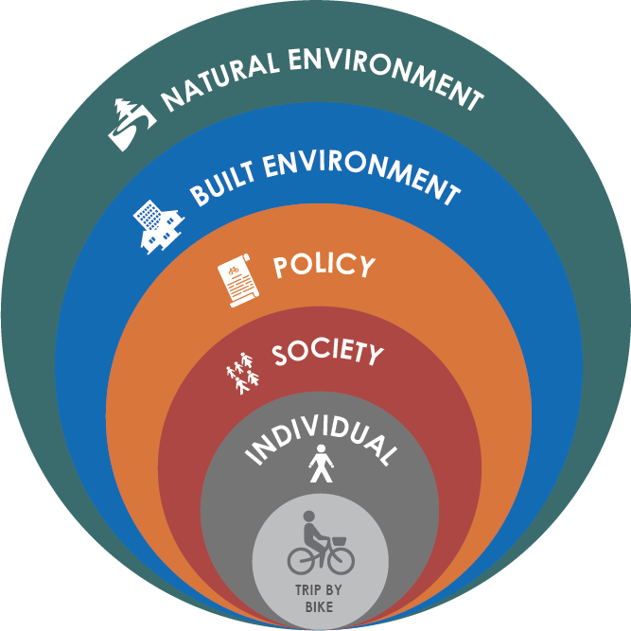
OUtline
Methodology
Where has cycling increased in Canada?
Definition of cycling increase
How has cycling increased?
Ten Actions in Five Spheres

Slide 3
methodology
Quantitative data sets
2. Case study interviews
3. Cycling program evaluations
4. Measuring benefits
Notes:
Evidence for this guide comes from five years of Canadian-specific work by researchers from Toronto, Montréal, and Vancouver.
Between 2014 and 2019, we analysed national demographic, geographic and transportation data sets (like Libby used), conducted interviews with municipal staff and community organizations, evaluated cycling programs, and carried out research on how to measure the cross-cutting benefits of cycling.

Slide 4
Notes:
Forty- two of Canada’s 100 census subdivisions with populations over 50,000, saw their rate of cycling to work increase between 1996 and 2016. This map shows the top 15 communities. Six of these communities are located in British Columbia, but the rest are spread across the country in both small and large municipalities. For example, Fredericton on the east coast has a population of just 58,000 people, and saw cycling increase by 68%. Quebec City saw a similar increase, and has a population of half a million. From one side of the country to another, these communities vary widely in terms of climate, topography and culture. What this project was interested in teasing out was the commonalities between communities that could point to successful strategies for cycling growth.
More information about the map:
15 communities with the highest growth in cycling to work in census subdivisions (using 2016 boundaries) in communities with populations over 50,000 and an absolute change in cycling mode share of at least 0.3%.
Overall, in Canada’s urban and suburban communities, trips to work or school by bike rose from 1.2% to 1.6% between 1996 and 2016

Slide 5
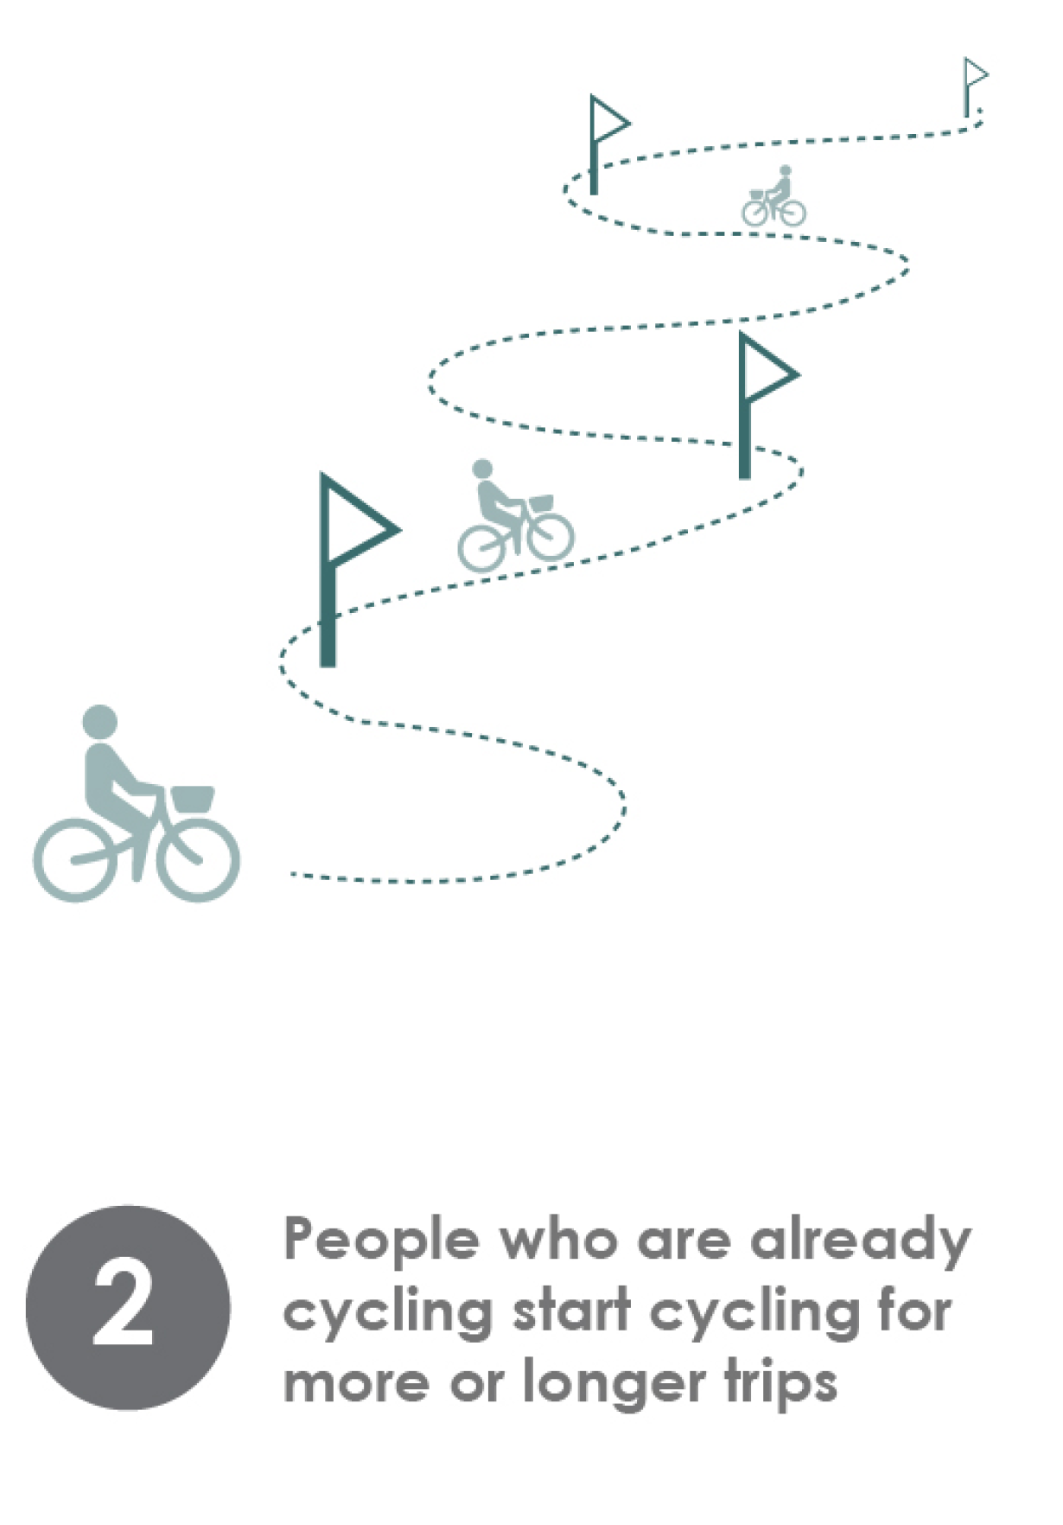
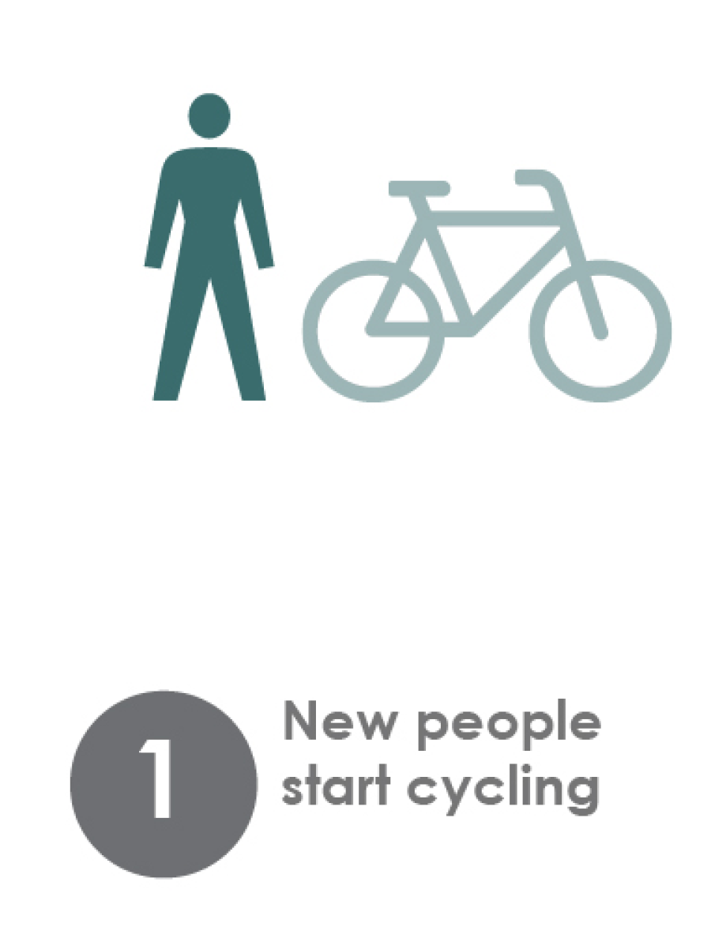
Defining Increased Cycling
Notes:
Before we get into those strategies, I’d like to pause a moment and talk about what we mean when we say increased cycling.
The conversation around increasing cycling tends to focus on cycling adoption, that is getting new people to start cycling for transportation.
In fact, there are three different ways cycling can increase: people start cycling who didn’t previously travel by bike, people currently cycling start cycling for more or longer trips, and people who are already cycling continue to cycle throughout life’s transitions when they might have otherwise stopped cycling, for example when they have children, or move further away from their place of work.

Slide 6
Notes:
Overview of Ten Key Actions to Increase Cycling (organized under the 5 spheres of individual, society, policy, built environment and natural environment)
Based on Evidence from our original research as well as the literature - Developed through the process described (quantitative data sets, case study interviews, cycling program evaluations, scan of how benefits can be measured)

Slide 7
Individual: Key Actions
Notes:
On an individual level, the feasibility of making a trip by bike is affected by the characteristics of both the trip and the person traveling. Long trip distances, poor route quality, and the need to carry bulky items or transport children can all deter cycling, as can inexperience, lack of access to a quality bicycle, and easy access to a vehicle.
The context of society, policy and built and natural environments all play a role in shaping these factors, but there are also actions at the individual level that communities can take to address these individual-level cycling barriers.
Communities can ensure there are safe and fun opportunities to try cycling. Bike to Work Day and Open Streets are good examples of this, but programming may also need to be more targeted to specific, under-represented groups, such as women, seniors or newcomers. They may also need to be even more supportive, for example by providing participants with access to a bicycle. Programs should aim to create lasting connections between participants, as positive social connections based around cycling are critical to adopting and sustaining a change in behaviour.
When it comes to sustaining cycling, municipalities can take a similar approach, recognizing that instead of adopting a new behaviour, participants are adapting an existing behaviour to suit a new stage of their lives. This might look like providing families with the opportunity to trial a cargo bike, or starting a cycling club out of a local seniors centre to provide that social support.
I’d like to emphasize that for both sparking cycling adoption and sustaining life-long cycling, safe infrastructure for all ages and abilities is a key ingredient, and we’re going to talk about that a bit more later.

Slide 8
Example: Bike Host CultureLink Settlement and Community Services
Long-term bike loan
Mentor matching
Social connections
Significant increases in cycling
Notes:
A study of two cycling mentorship programs in Toronto and Brampton, Ontario, found that the program increased cycling. Participants were loaned a bicycle and matched with a local cycling mentor for three to four months. Together, the participants and their mentors explored their neighbourhoods by bike through a mixture of small group rides and larger special events.
At the close of the program, 74% of participants did their shopping trips by bike at least some days of the week and 45% commuted by bike, compared with only 25% and 10% before the program. Cycling increased in suburban as well as more central areas. How much participants were willing to spend on a bicycle and accessories also increased.

Slide 9
Society: Key Actions
Notes:
Thanks, Beth! I’m going to be taking you through the next four categories of Society, Policy, Built Environment and Natural Environment.
Under society, we’re talking about culture, and does a culture of cycling exist. This plays out through social norms related to cycling, community support of cycling, and peer cycling behaviour.
In the case studies we conducted, large-scale trends related to a growing cycling culture were cited as crucial to cycling’s growth in every one of the ten municipalities studied.
It can seem like cycling culture is outside of a municipality’s control, but there is much that a city can do to foster these trends and make them more inclusive.
A portion of our work focused on suburban communities with low cycling, and I’m going to draw on an example from Scarborough, Ontario to talk about two of the strategies on this slide:
Identify cycling potential and use partnerships to build cycling culture where it does not exist.

Slide 10
Example: Scarborough Cycles Access Alliance Multicultural Health and Community Services
Mapping to identify potential
Partners with mission alignment
Community bike hub offering supportive programs
Notes:
Scarborough is a suburb east of Toronto, where cycling is below 1% of all trips.
In 2015, TCAT launched a project called ‘Scarborough Cycles: Building Bike Culture Beyond Downtown”. We worked with with Dr. Savan’s group at the University of Toronto, and two organizations with expertise in cycling programming: Cycle Toronto and CultureLink Settlement and Community Services.
We started by identifying areas in Scarborough that had significant potential for cycling. The impulse is to see suburban neighbourhoods as all the same and all equally unsuited to cycling. In fact, the suburbs are diverse, and some neighbourhoods are more conducive to cycling than others. To find them, we mapped factors related to cycling, such as the percentage of trips under 5km, the average number of vehicles per adult in a household, and the density of cycling infrastructure.
We then looked for local partners to host community bike hubs in those neighbourhoods with high cycling potential. The partners had no experience delivering cycling programming, but they did have mandates that included health, environmental or community-building goals. We launched cycling programs out of their locations and gradually over two years, we devolved responsibility over to the local partners. Now, four years later, the local hosts are continuing to run the programs.
And the community response has been phenomenal. Over four years, we had over 6,000 participants in programs covering bike repair, workshops, rides, mentorship and advocacy, and we can see the culture norms starting to shift.

Slide 11
Environment
Economic
$$
Equity
Health
Notes:
As in the example I just described, we’ve found that partnerships have been key to the success of cycling projects in suburban and small communities.
Data can play a role in building these partnerships by identifying cross-cutting benefits.
As part of this project, we conducted a scan of benefits of increased cycling, and evaluated the evidence behind these benefits. We created a list of benefits that have all been demonstrated through multiple research studies with rigorous methodologies and consistent results. We then provided recommendations for ways cycling professionals can practically apply the established research to their own context, in order to build cross-sectoral support for cycling plans and projects.

Slide 12
Policy: Key Actions
Notes:
Continuing to move outwards through the spheres, we’re now on policy.
Establishing a cycling plan as a policy document puts cycling on the table and makes it a legitimate part of the transportation planning discussion. It can also spark major investments, and we’ve seen how it results in changes in the structure of local transportation planning departments to create staff positions dedicated to cycling.
However, policies outside of the cycling plan also have an influence – for example, built environment and land use planning, parking policy and restrictions on car use.
Policies coordinated with each other and implemented in conjunction with programming will have a greater impact than any single policy action undertaken on its own.

Slide 13
Example: Montréal
Culture first
Staff resources and plan
Infrastructure and programs
Notes:
An example of a Canadian city where coordinated efforts have paid off is Montreal.
As we saw on the map earlier, over the past twenty years, cycling has grown 176% in Montreal.
What’s interesting is that some of the first steps they took twenty years ago were around building culture: In 1999, Vélo Québec started hosting a large-scale, family friendly Bike Festival, which is still going on today, and closes the streets to cars so thousands of cyclists can ride together.
In the early 2000s, the City started work on a new cycling plan, and increased the number of staff working on cycling from two to 14.
The plan led to major infrastructure expansion. In five years, the City built 200km of bike lanes, including the first separated cycle track in North America to go through a major downtown.
Infrastructure expansion has been paired with other policy and program efforts including a bike share system, a four season cycling network, policies that close some streets to cars all summer long, and community bike hubs to help marginalized populations access cycling

Slide 14
Built Environment:
Key Actions
Notes:
Our next sphere is Built Environment, and this is where we talk about infrastructure directly, although it’s already been mentioned a number of times in relation to the other four themes. We know that installing cycling infrastructure can improve cyclist safety dramatically, and this translates into more cycling.
In Canada, over the past twenty years, cycling has seen larger increases in places with more on-street infrastructure.
In fact, the top neighbourhoods for cycling in Canada in 2016 had almost four times more cycling infrastructure than neighbourhoods with less cycling.
It’s important to remember that a regular grid pattern of low-speed streets can supplement a dedicated cycling network by providing quiet alternatives to the main road. Canadian cities and towns that have more four-way intersections have also seen larger increase in cycling.

Slide 15
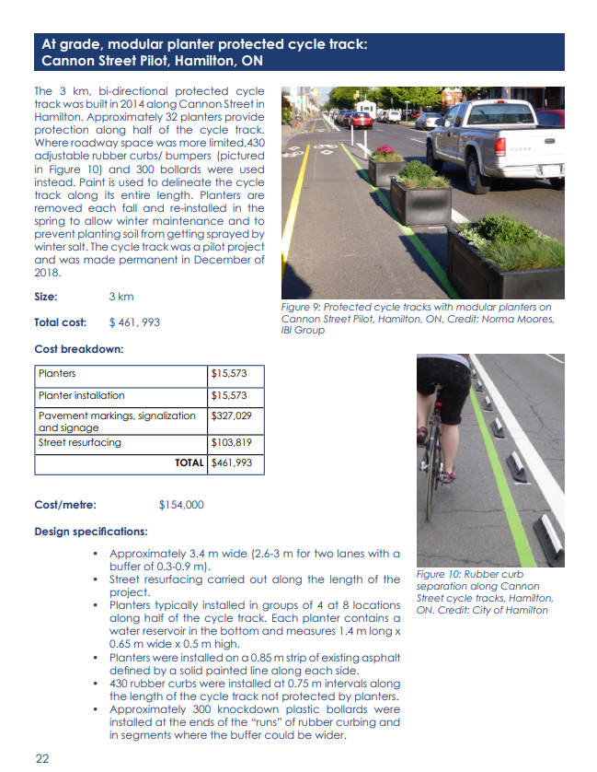
Resource: Costing of Bicycle Infrastructure and Programs in Canada
Notes:
In terms of examples, there are many excellent design guides out there, which we didn’t want to replicate. We did find, however, that there was a gap in costing information of Canadian example projects, both on the infrastructure side and on the programming side. So in tandem with our Guide, we also released a catalogue of 29 infrastructure measures and 11 cycling programs found in Canadian cities, with a description of the resources and costs involved for each.
I encourage to head to our website and download the Catalogue if you’re interested. One takeaway for us was just how cheaply many of these interventions can be implemented, using semi-permanent materials like planters and modular curbs. But even more expensive projects, though, are affordable when compared with roadway construction for cars.

Slide 16
Natural Environment:
Key Actions
Notes:
And now we’re on our final sphere: the Natural Environment
Cold winters and hilly topography both present challenges for travel by bike. But it’s a mistake to let that be the end of the conversation.
If you work in cycling in Canada, you’ve no doubt heard someone say, ‘Cycling is great, but what about the other six months of the year?’ This critique is not based in evidence. Even in Canada’s snowiest cities, Ottawa, Montreal, Winnipeg and Calgary, the average number of days per year where they receive any snow is 54. Which leaves many cold, clear days for cycling, if the road is clean and ice-free. As we’ve seen, Montreal has experienced enormous growth in cycling trips. So there are other factors at play here, and while municipalities cannot change the weather or the landscape, they can mitigate against their impacts.

Slide 17
Example:
Calgary
Quality infrastructure
Priority snow clearing
Winter cycling programs
Notes:
I chose Calgary as an example. Calgary is city known for its cold, and not really for its cycling, but that’s beginning to change.
They installed cycle tracks going right through their downtown and are now seeing winter cycling numbers there that are comparable to summer cycling numbers before the cycle tracks were implemented
The downtown cycle tracks are classified as Priority 1 for snow-clearing, meaning that they are cleared within 24 hours of a snowfall. All other on-street bike lanes are Priority 2, meaning they are cleared within 48 hours.
This past year, they also ran a promotional campaign around winter riding, including a winter cycling photo booth and ‘Who bikes in the winter?’ profiles, which told the story of everyday Calgarians who bike year round.

Slide 18
Next Steps
Expanding Community-Based Research
Evaluating Synergistic Impacts
Further Focus on Suburban Environments
Notes:
•Expanding Community-Based Research
-A lot of work being done by community groups, cycling advocacy groups, as well as municipal staff – collaboration with academic researchers can improve program promotion, design and evaluation. But CBR requires compromise and negotiation to align contrasting researcher and professional agendas
•Evaluating Synergistic Impacts
A lot of great work has been done on evaluating the impact of key interventions, such protected bike lanes. It would be great to see more research on how the impact of new infrastructure can be supported or amplified by programming interventions as well. Or how infrastructure can be amplified by a policy change, such as reduced speed limits, implemented at the same time. Synergistic impacts are difficult to evaluate but critically important to program success.
•Further Focus on Suburban Environments
-We see the suburbs as the next frontier for cycling, and we’ve found that working there is different. Given the low rates of cycling currently, we need to identify areas with likely latent demand and build a cycling community. More research is needed that is specific to this context.

Slide 19
Thank you
Notes:
We’d like to thank our funders for making this work possible: the Social Sciences and Humanities Research Council of Canada, and the Metcalf Foundation.

Slide 20
More information
www.tcat.ca/project/increasing-cycling-in-canada/
Beth Savan
University of Toronto
b.savan@utoronto.ca
Yvonne Verlinden
The Centre for Active Transportation
yverlinden@cleanairpartnership.org
Notes:
More information

