Slide 1
Green Procurement
Summery Notes of December 4th , 2018 Webinar

Slide 2
Content:
Trisha Henderson, Town of Oakville Green Procurement Actions and Update
2. Natalie Adams, City of Mississauga Green Procurement Actions and Update

Slide 3
Sustainable Purchasing Procedure Trisha Henderson, Town of Oakville Green Procurement Actions and Update
Timeline
2006 – Environmental Strategic Plan – (Provide a baseline for Policy) goals and actions related to efficient use of resources; limiting toxic materials; reducing waste; collaboration and creation of measurements
2009 – Environmental Sustainability Policy with 7 goals and procedures, such as Zero-waste, Green Fleet, Sustainable Purchasing Procedure - with 5 year review schedule
[Policy approved by Council, Procedures developed and implemented by staff (where council are not directly involved in approving procedures, however the council is provided with information about the implementation of the procedures]
2010 – Made environmental amendments to the Purchasing By-law, heavily focusing on included environmental clauses
Strengthen relationship with Recycling Council of Ontario: applied for awards; joined programs – 3RCertified (in-depth cycle of the facilities) – certified town hall
2012-2013 - Council commit of building new buildings with LEED silver standard
2016 – Review and updated of the Purchase By-law
Implement towards Zero-waste
Made connection between litter By-law, Special events user guide, Work plan, and Waste Audit Work Plan
Sustainable Purchasing - 4 goals – incorporate Climate Change

Slide 4
Town of Oakville Green Procurement Actions and Update
Important Motions
The new amendments were listed as Schedule
This motion allowed easy changes (instead of going through the by-law and create new amendments, make changes directly to the Schedule)
Schedule H – Single or Sole Sourced Procurement Activity
Helpful for waste audit – to standardize the waste in all facilities
Allowed for clear requirements and different approval levels, also opened the door for green procurement
Local Sourcing – challenge - needs requirements to build the case (Agreement on internal trade)
Local Preference Clause was written partly because of the Silver LEED standard – because it has to consider locally sourced products.

Slide 5
Town of Oakville Green Procurement Actions and Update
Important Motions
Schedule J – Environmental Sourcing & Procurement
Life-cycle analysis
Steps
Step 1 – Assessment Opportunity
Step 2 – Assess Internal Supply Chain
Step 3 – Assess Supply market
Step 4 – Develop Sourcing Strategy
Schedule K – Development of Specifications - waste, packaging, printing
No Local Preference Clause

Slide 6
Town of Oakville Green Procurement Actions and Update
Important Motions
Stakeholder Education
Halton Cooperative Purchasing Group (HCPG) – schoolboards, police services, local municipalities, regional municipalities, - A lot of effort but it helped to collaborate and create win-win practices (as every group has its own initiatives)
Vendor awareness – pre approved (eApproved) vendors to make sure they have certification (Vendor showcase and Open house helped)
Staff education – having decentralized purchase system with different credit card holders. Education of purchasing staff, admin assistants (responsible for office supply orders), managers, and new hire package
Internal site – information for trusted certification, toxic materials
Tools for life-cycle costing/calculators
Reading labels guide

Slide 7
Town of Oakville Green Procurement Actions and Update
Actions
Remove bottle water – all vending machines to remove their water bottles in the town and to use most energy efficient machines
Implement water fountains + portable units
Add compost – challenges in having only one halter
Switched light contractor – mercury removal and recycling – change vendor
Switched janitorial supplies
Electrical fleet
Duplicating Paper
Paint – less plastic materials
Coffee machine with only compost waste
Banning straws

Slide 8
Town of Oakville Green Procurement Actions and Update
Measurables
Helpful services and motions:
Staples Eco Easy – providing metrics
Accepting that the right purchase not always have a measurable
Corporate Express – green alternatives for office supplies, they take back all boxes, corporate catalogues, provide measurements of green items bought from them

Slide 9
Town of Oakville Green Procurement Actions and Update
Lessons Learned
Continues and consistent effort
Champions within department
Centralize purchasing office supply system – may be beneficial to control oversupply
Recognizing people’s effort – Kudo’s at the company’s newsletter

Slide 10
Making Better Choices Natalie Adams, City of Mississauga’s Sustainable Procurement Initiative Actions and Update
Policy Development & Implementation
2016 – Stakeholder Engagement – explore the vision of Stakeholder (construction, social, environmental, and business sector) on Sustainable Procurement. Also, to support Mississauga advancement strategic priorities. Community and Consultant was put together and
2017 - Policy Development/approval with hired designated Sustainable Procurement & Implementation Coordinator to build Training and Communication Plan
2018 - Piloting Sustainable Procurement Policy

Slide 11
City of Mississauga’s Sustainable Procurement Initiative Actions and Update
Support City Priority
Aligning the policy with already existing strategic plans and policy
- Move Belong Connect Prosper Green – attract business, maintain infrastructure, social procurement in a sustainable manner
- Living Green Master Plan – training and corporate priorities regarding purchasing
Supplier Code of Conduct – assuring that any vendor’s work meets the international label organization and minimum standards for ethical and responsible sourcing (such as force labor, child labor, nondiscrimination, health and safe work environment).

Slide 12
City of Mississauga’s Sustainable Procurement Initiative Actions and Update
Defining Sustainability
Three Pillars: Environmental; Ethical; and Social
Sustainable Procurement defined in the Policy Considering social and environmental factors in the procurement process, in addition to traditional factors such as price, quality and service.
The Policy does not require or mandate any actions, rather reminds and ask for consideration

Slide 13
City of Mississauga’s Sustainable Procurement Initiative Actions and Update
Environmental Aspects
Reduce material use and divert waste
Use energy efficiency
Reduce GHG emissions and air pollution
Mitigate climate change
Conserve water
Reduce toxins and hazardous chemicals
Preserve biodiversity and restore habitat

Slide 14
City of Mississauga’s Sustainable Procurement Initiative Actions and Update
Ethical Aspects
assure fair practices within production facilities
Human rights
Working conditions
Safety
This is assured by the Supplier Code of Conduct but some areas do need a third party verification

Slide 15
City of Mississauga’s Sustainable Procurement Initiative Actions and Update
Social Aspects
improving health and well-being of individuals within our community
Employment opportunities – association of colleges or universities, training options
Skills and training
Social enterprises
Challenges – cannot prefer purchase based on geographical location

Slide 16
City of Mississauga’s Sustainable Procurement Initiative Actions and Update
Implementation Planning
3-year implementation plan (2018-2020)
3 goals (2020)
Leadership
Impacts
Integration
6 objectives (2020)
Build Staff Capacity
Implement Tool & Procedures
Seize High-impact Procurement Opportunities
Perform Routine Sustainable Procurement & Quick Wins
Cultivate Stakeholder Relations
Monitor Evaluate, and Plan

Slide 17
City of Mississauga’s Sustainable Procurement Initiative Actions and Update
Immediate Activation Steps
Develop a Change Management & Communication Plan
Implement the Supplier Code of Conduct (in medium and high value bids – more than $10K)
Provide Employee Training (five phases)
Identify Quick Win Sustainable Procurement to Test Approach

Slide 18
City of Mississauga’s Sustainable Procurement Initiative Actions and Update
Communication and Training
Orienting – internal audience are aware of the Policy and how it relates to their role
Learning – showing actual tools, teaching about the value of green procurement to the Mississauga city, helping creating a business case
Practicing – activities and practices, applying criteria for upcoming procurement
Mastering
Maintaining
*building a webinar

Slide 19
City of Mississauga’s Sustainable Procurement Initiative Actions and Update
Progress on 2020
Leadership
Phase 1 – Introduction
Phase 2 – Implementation
Impacts – achieved measured improvements as a result of procurement activities
Fairtrade coffee
70% Green Products of Office Supplies
10% Cleaning Contract with Cleaning Industry Management Standard

Slide 20
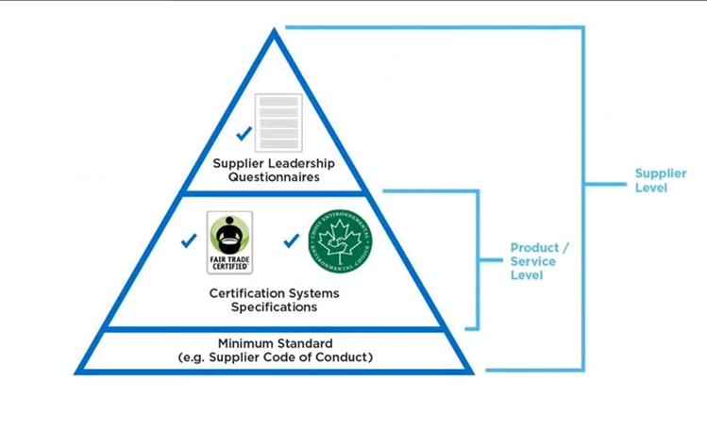
City of Mississauga’s Sustainable Procurement Initiative Actions and Update
Progress on 2020
Integration - “How do the contact members and contractors know it’s sustainable? “
- Industry guidelines and assessment tools | Supplier/brand claims and disclosure | Independent third party verification/certification
Our own verification process –
Sustainable Procurement Trifecta
Supplier Leadership Questionnaire – (ex.“How sustainable the vendor is?” )

Slide 21
City of Mississauga’s Sustainable Procurement Initiative Actions and Update
What’s Next
Phase 3 Training – Practicing and Mastering
Supplier Engagement Forums
Measuring impacts with KPI’s
Vision of Success
Staff aware of sustainability impacts/opportunities
Sustainability considered/embedded in City bids
Supplier engaged in solutions & innovation
Measurable results and success stories

Slide 22
Discussion
1. How much of percentage of time was allocated to the sustainable component of the job?
Mississauga: 100%
Oakville: 40%
2. What does the vendors has to show for pre approval/to get recognized as a green vendor?
M: based on a score (10 points), sign Supplier Code of Conduct
O: - it is a check list, providing certifications, and reviewed afterwards, and score based

Slide 23
Discussion
3. How the life-cycle cost is embedded into the sustainable procurement in order to make the connection of sustainable and financial feasibility?
M: Getting the total cost (ex. Fleet – price+ fuel efficiency over 10 years – to evaluate the vehicle)
O: Buildings and Fleets are more easily to justify. Otherwise it is a challenge with smaller purchases
4., In regards to measurements – are there any other area (except Office supply) where the vendor/supplier is providing measurements?
The first priority is to find out how to get measurables with the vendors/suppliers and improve further, rather than take it on internally as it is difficult to do tracking and monitoring.

Slide 24
Discussion
5. What kind of criteria do you use to determine where you should meet data requirement or allocate points to requirement? Or there is a policy?
M: It depends! Proposals allows to evaluate the solution and price where you can make requirements mandatory or worth points.
O: we created: 5 requirements/wish list
6. Is it possible to replicate Toronto Junk Program to share some oversupply materials?
Yes. There is also an internal way of relocating needed materials.

Slide 25
Discussion
Poll results:
More webinars in 2019 before face to face meetings
Continues to sharing experience with other municipalities.
Google type group for sharing questions about green procurement.

