Slide 1
Green Procurement
Opportunities and Best Practices

Slide 2
D # 1: Green Procurement
Green Procurement was identified as a priority action area for municipalities in Clean Air Council and Partners for Climate Protection:
Continuous improvement related to implementation of corporate energy conservation, green procurement and green fleets plans.
4 webinars on updates on Green Procurement actions
Update to 2012 Green Procurement Scan
Identification of barriers and discussion on possible ways to address barriers
Face to face workshop in late 2018 - November 23rd, 2018

Slide 3
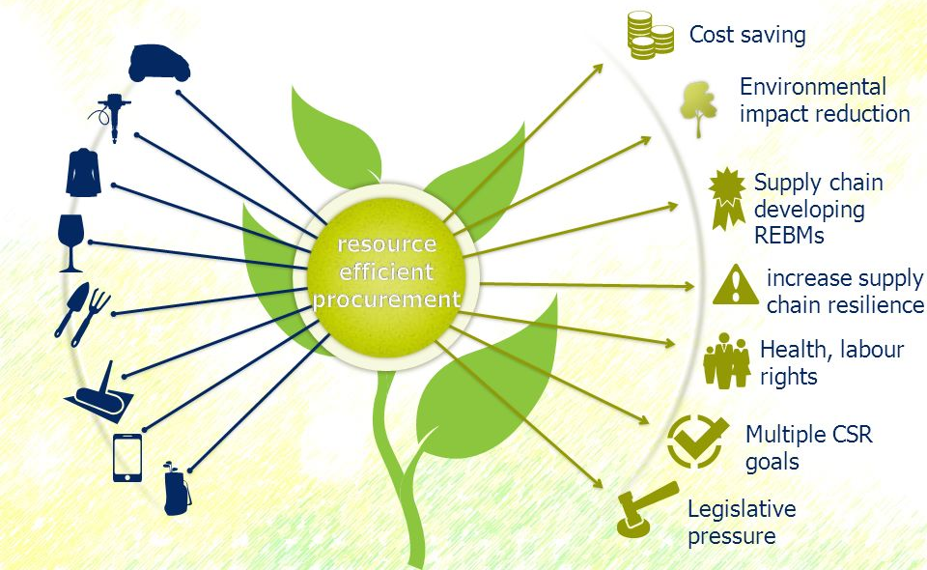
Green Procurement and Why it Matters
At least $100 billion is spent by all governments in Canada and MASH sector
Local government’s procurement spend of goods and services, create unique opportunities for sustainability benefits
Each municipality is developing their sustainable purchasing policies, programs, procedures, and contract specifications. Significant benefits in sharing experiences, lessons learned and resources.
Notes:
Does not need to be a whole new way of purchasing. Many municipalities and other organizations are already
undertaking efforts to optimize the way in which they procure goods and services: implementing sustainable purchasing can piggyback on these changes, or alternatively, may catalyze many other positive changes that increase the efficiency of the buying process, and the strategic value that purchasing departments provide within their municipalities – both internally and in a public-facing way.
Strategic Supplier Relationships
Eco-efficiency and Sustainability benefits
Engaged Employees
Brand enhancement
Financial ROI
Risk Reduction

Slide 4
Value of Green Procurement
Helps meet sustainability goals (reduce energy consumption, water use, air pollution and greenhouse gas emissions, minimize/zero waste, avoid highly toxic chemicals, equity and diversity, etc..)
Save money by lowering the municipality’s use of electricity, fuel, water, paper, or other resources. Some green products, such as remanufactured toner cartridges, have a lower upfront cost. Many green products have lower lifecycle costs.
Create new environmentally responsible jobs (i.e., promote “green” growth).
Lead By Example
Serve as a proving ground for innovative technologies that offer measurable environmental and health benefits
Have a transformational effect on the marketplace
Notes:
Strategic Supplier Relationships
Eco-efficiency and Sustainability benefits
Engaged Employees
Brand enhancement
Financial ROI
Risk Reduction

Slide 5
Business Case for Green Procurement
Enables municipalities to gain experience with sustainable products and services; gives credibility to encourage others to do so as well
Reduce energy use and costs and greenhouse gas emissions
Zero-waste goals
Water conservation
Improved air quality
Social responsibility, diversity, equity, local economic development goals
Save money by favoring products that are more resource efficient, last longer, and have lower maintenance and disposal costs

Slide 6
Green Procurement Questions
How to identify and prioritize green purchasing opportunities?
How to understand the markets for green products and determine appropriate green specifications to use?
How to choose the purchasing method that is most likely to result in competitive bids for green products and services? Are there shortcuts? And how to best design bid documents to support that?
When the bids are returned, how to evaluate the green attributes of products and services offered by bidders to ensure they meet the environmental criteria established in the bid specifications and achieve best value?
In what ways can the municipality promote the availability of green products and services that have been added to its contracts in order to increase awareness and the green spend by others.
How to effectively track and report “green” product spending?
Hearing from other municipalities on what
Other questions that come to mind??????

Slide 7
Experience Sharing - Green Procurement Pathway
Identify who is doing what at present to advance green procurement
What resources and expertise has been developed and is able to be shared?
Identify and work collaboratively on high-impact green procurement procedure opportunities
Each municipality taking the lead in one area of green procurement
Enhance and strengthen municipal sustainable procurement efforts by learning about and implementing best practices developed and tested out by others
This doesn’t need to be done alone, but each action within a municipality breeds action in other municipalities

Slide 8
Green Procurement Pathway
Communicate the business case for green/sustainable procurement to internal and external stakeholders for how it can help meet sustainability goals and contribute to building local economy
Develop clear and actionable policies – What does that look like? More to come….
Identify high-priority sustainable procurement opportunities – identify low hanging fruit
Establish clear, defensible and effective sustainable procurement standards and procedures in order to implement policy (writing specifications, developing bid solicitation documents, evaluating offers). Implement those procedures/standards.
Promoting and monitoring the usage of green products — to more easily identify and maximize green purchasing opportunities.

Slide 9
What Makes for a Good Policy?
A comprehensive sustainable procurement policy lays the foundation for an effective procurement program, especially when it is supported by council, was created by a number of departments (Ideally including, council champion, has senior management support from a number of departments, and procurement and sustainability staff efforts are acknowledge and rewarded.
Clearly delineate staff roles and responsibilities – who does what and what is expected?
Calls for the creation of sustainable procurement plans, procedures, and implementation tools.
Directs the municipality to make sustainable procurement the “default activity” for major purchasing decisions and set procurement goals.
Encourages employees to use credible eco-labels and “best value” assessment methods when making purchasing decisions.
Includes tracking and reporting requirements.

Slide 10
What Makes for a Good Program/Procedure
Dedicated staff time, including a central point-of-contact and technical support needed to identify sustainable attributes of products and suppliers.
Periodic planning and prioritization to identify upcoming high-impact opportunities.
Development of Sustainable Procurement Procedures Manual: including model specifications, vendor survey questions, contract boilerplate language (related to applicable policy language, approved eco-labels, chemical restrictions, product labeling, packaging standards, product take-back and recycling requirements, “green” spend reporting, piggybacking, etc.).
A team approach to undertaking sustainable procurement actions (internally and externally).
Ideally including sustainable procurement in applicable staff performance reviews and cover sustainable procurement in existing staff training and vendor outreach materials.
A coordinated education and outreach program for staff and vendors (one-stop sustainable procurement website that highlights sustainability policies, specifications, contracts, success stories, training and promotional videos, progress reports, etc).
Tracking and reporting sustainable purchasing activities, accomplishments, and impacts.

Slide 11
Possible Roles and Responsibilities
Purchasing takes the lead in convening a product specific Sourcing Team (which includes high-volume contract users) for each targeted sustainable procurement actions, provides background on contract scope, timeline and procurement strategy (RFP or Invitation to Bid) and provides past bid solicitation documents including specifications, bid sheets, core list, historic usage data.
Sustainability/Environment takes the lead in supporting Purchasing and the Sourcing Team (identifying applicable standards and credible 3rd party certifications, specifications, vendor survey questions, possible contract language). During the evaluation process support purchasing with sustainability related questions.
End-users should participate in Sourcing Teams; share experiences with products; approve sustainability specifications; possibly test sustainable options.
Goal: sustainable procurement should be a cut and paste activity, where purchasing use pre-populated sustainable procurement templates that are developed for target product categories.

Slide 12
Setting GP Priorities
Do try and do it all at once; maximize impact and minimize implementation effort by identifying your municipalities prioritization process (possible priorities can be determined based on criteria (High-spend/High-impact/Easy to implement/Likely to yield multiple benefits/Innovative/etc..).
Choose a specific type of product (e.g., bottled water, cleaning products, food, or paper) or promotes a specific sustainability outcome (e.g., buy local, climate protection, sweatshop-free, or toxics reduction).
Use third-party labelling systems wherever possible.

Slide 13
Recommended Possible Actions
Look for opportunities to use existing contracts that have been developed by a neighboring municipality
Tailoring bid solicitation documents (including specifications and vendor survey sheets that have been developed by others)
Survey the market – Request for Information or informally through online research and pre-bid meetings to assess availability, price and performance of green procurement suppliers
Conducting a pilot test to identify the sustainable products
Referencing third-party certifications
Evaluating vendors through a sustainability questionnaire

Slide 14
Recommended Possible Actions
Ensuring compliance with specifications during the bid evaluation process and awarding points to bidders that offer additional sustainability services
Developing “all-green” contracts, which may secure lower prices on sustainable products and makes education and tracking easier
Awarding the contract to multiple vendors of sustainable products to give contract users product choices and to foster price competition over the life of the contract
Consider awarding some or all of the sustainable products separately to enable vendors that do not offer conventional products to compete
Ensuring that all products offered on the contract meets the sustainability criteria in the bid solicitation document
Promoting the sustainable products on your new contract to end-users soon after the contract has been awarded
Notes:
To promote price and product selection competition, bid green items separately or allow line-item or multiple awards on contracts with green products.

Slide 15

Green Procurement Prioritization –
GP Opportunities
Where third-party labels are applicable
Electricity, Fuel and Water savings
Recycled Content
Reduce Toxic chemicals (environment and worker exposure)
If a contract comes up for bid and greening it is likely to yield a significant environmental benefit

Slide 16

Green Purchasing Team
Procurement
Environment Office
Facilities
Public Works
Fleets
Other Department Reps
Other Joint Purchasing Partners?
(police, schools, other municipalities)
Notes:
Green Purchasing Team representatives collectively have knowledge of the commodities and services that are used by their departments, they can identify and prioritize potential green opportunities better than individual purchasers can on their own. They can also help identify end-users, conduct outreach, and track green spending in their agencies.

Slide 17
Green Certification
How the %^&* am I supposed to know what is the “environmentally preferable choice”?
That’s the label’s job…
Don’t rely on claims from manufactures and suppliers
Rely on claims from third-party certification bodies
This will avoid greenwashing – the practice of misleading consumers about the environmental or health benefits of a product or service.
Highlighting a product’s single environmental benefit while ignoring other significant environmental hazards
If third party certification is not available require vendors to verify all of their environmental and health claims.
Separate Powerpoint on Green Certification and Greenwashing

Slide 18

Adding Green Products to Bid Solicitations
Specifying a Single Certification or Rating
Allowing for Different Certifications of the Same Attribute
Specifying More Than One Certification to Account for Different Attributes
Requiring documentation for green claims not certified by 3rd party

Slide 19

Considerations While Constructing a Bid
Should the Green Products be Mandatory?
Should the Green Products Be Bid Along With Conventional Product Alternatives?
How Can the Expected Volume of Green Products be Determined?
Can Green Specifications Be Added to Service Agreements?

Slide 20
What Steps Can be Taken to Try to Lower the Cost of Green Products?
Remember not all green products cost more
Contract for green products only, to secure higher price breaks.
Promote the use of green products offered on municipal contracts.
Construct a green core or market basket list.
What Can You Do When a Green Product Still Has a Higher Upfront Cost After Market Basket Discounts?
Consider whether green products represent the lowest “Total Cost of Ownership” based on a life-cycle cost analysis.
Offer a price preference for green products.
Set up a point system that rewards green products and services.
Notes:
But when their upfront costs are more be sure to factor in total costs (life-cycle costs into cost analysis)
Offer a price preference for green products – enables the green product to be considered competitive within a % of conventional product/service
Set up a point system for green products

Slide 21
How Can the Best Selection of Green Options Be Encouraged?
Conventional vendors may carry only a few green products or the green products vendor may not carry conventional products at all. May be necessary to solicit bids for the green products separately from conventional products
Publicize your new green bid solicitation widely
Consider holding a pre-bid meeting, preferably early on in the contract development process
You may also want to hold a meeting immediately after the bid solicitation has been issued to make sure bidders understand your specifications and bid evaluation procedures
Notes:
A conventional vendor may carry some green products but not a wide variety, and the green products vendor may not carry conventional products at all. may be necessary to solicit bids for the green products separately from conventional products rather than requiring a single vendor to provide both. This can be accomplished by developing a separate bid solicitation for green products or by allowing bidders to make offers on individual line items or categories of products (e.g., a green products list).
Publicize your new green bid solicitation widely. The vendors with the widest selection of green products may be focused on consumer markets and may not be aware of your bid. One way to find distributors of green products is to contact the certifier you have chosen to distinguish your green products, who can then pass information along to vendors of certified products.
Consider holding a pre-bid meeting, preferably early on in the contract development process. This will enable you to collect market availability and performance information from vendors in the region and give potential bidders time to become a State-approved vendor or set up an arrangement to Green Purchasing Opportunities and Best Practices (RPN, 2013) 13

Slide 22
Vendor Sustainability
Municipalities can extend the influence of their direct purchases by encouraging vendors to go beyond simply offering certain green products and services by implementing sustainable business practices themselves. T
The Vendor Sustainability Questionnaire is designed to help purchasing agents evaluate whether their vendors conduct their business in ways that yield environmental and health benefits.
Vendor code of conduct goes beyond products and services and gages how sustainability factor into the businesses operations.

Slide 23
Once the Bids Are In
Evaluating Green Products and Services Offered by Bidders
Confirming that the products meet the bid solicitation's minimum environmental requirements
Verifying certifications and claims
Evaluating pricing
Determining any point awards
Arranging for performance testing, if needed

Slide 24
LCCA and LCIA
Performing an Lifecycle Impact Assessment (LCIA) is a different process than an Lifecycle Cost Analysis (LCCA) .
An LCIA is a method of assessing environmental impacts associated with all the stages of a product's life from raw materials to end-of-life (also known as cradle-to-grave).
A LCCA is focused on the economic impacts of a given project.
LCCAs can often be conducted by purchasing agents to compare the total cost of ownership of competing products
LCIAs are often much more complex and rarely (if ever) attempted by purchasing staff.
However don’t be shy about asking suppliers if they have LCIAs for their products (education opportunity).

Slide 25
Easy Green Procurement Language
Third-Party Green Certifications, Or Other Verification of Claims
Sample Language Suppliers citing environmentally preferred product claims shall provide proper certification or detailed information on environmental benefits, durability and recyclable properties.
Use of Environmentally Preferable Products
Sample Language Contractors should use environmentally preferable materials that meet performance requirements wherever practical in the fulfillment of this agreement. Environmentally preferable products and services have characteristics that include, but are not limited to, the following:
Energy or water efficient
Reusable or upgradeable
Recyclable
Contain postconsumer recycled materials
Produce fewer polluting byproducts or safety hazards during manufacture, use, or disposal
Are certified by an independent, third-party eco-label (e.g., Green Seal, EcoLogo, etc.)

Slide 26
Vendor Packaging
Elimination of Unsustainable Packaging
Sample Language Describe the delivery packaging, and the recyclability thereof, that will be used for the proposed products. Specifically address:
Packaging materials used
Recycled content of packaging materials
Recyclability or compostability of packaging at facilities
Whether packaging is taken back by your firm (as part of delivery services) for reuse or recycling
Your firm’s efforts to minimize packaging without compromising product quality and integrity
Contractors shall eliminate [insert specific prohibitions on packaging such as PVC or polystyrene due to environmental and human health concerns].

Slide 27
Additional Strategies for Upping Green Impact
Labeling green products on online ordering systems or catalogs
Highlighting successful use and environmental benefits of the product in internal communications such as a newsletter or email updates
Distributing samples of the product to end-users, along with a flyer about its quality, environmental benefits, and price, if relevant
Hosting a vendor demonstration of the product for end-users
Ensuring that any necessary accessories are available and conveniently integrated into staff members' workdays. For example, converting from conventional disposable batteries to rechargeable batteries requires the purchase of chargers and easy accessibility to them that fits within staff members' work environments.
Sponsoring competitions for most complete conversion to using the green products
Conducting feedback surveys of end-users on their experiences with a particular green product
Publicizing the environmental savings that are achieved by using a particular green product.

Slide 28
Tracking and Reporting Results
While tracking the impacts of a municipality’s sustainable procurement activities is a challenging task, it is an essential element of a program’s long-term success because it can help the Sustainable Purchasing Team:
Effectively make the case for a sustainable procurement program by demonstrating that it is helping them meet their sustainability goals;
Convince municipal leaders to devote more financial resources to the program;
Demonstrate to policymakers and the public that the jurisdiction’s sustainable procurement policy is being implemented;
Gain credibility with the community by demonstrating how their jurisdiction is “leading by example;”
Qualify for sustainability awards, certifications, and grants; and
Identify opportunities for improving the jurisdiction’s sustainable procurement program.

Slide 29
Vendor Assistance with Tracking “Green Spend”
Sample Language Contractors are required to provide [frequency and type of reports quantifying products with green attributes] purchased under this contract. This report shall contain the detail required by [municipality], which may include, but is not limited to, type and quantity of product purchased with the following green attributes…..

Slide 30
Tracking and Reporting Best Practices
Incorporating tracking and reporting requirements into your jurisdiction’s sustainable procurement policy
Developing a tracking and reporting plan that identifies key performance indicators (KPIs)
Tracking sustainable procurement activities (such as the number and dollar value of new contracts that were created) and impacts (such as number of sustainable products that were purchased as well as resulting environmental, health, and economic benefits)
Requiring approved vendors to provide data on the amount of sustainable products and services they sold to your jurisdiction on an annual basis
Establishing all-green contracts to make the “green spend” tracking process easier
Communicating the results of your tracking efforts to policy-makers, employees, and the public on an annual basis
The results of your tracking program can provide valuable insight about how well your sustainable procurement initiatives are working and can help your team identify opportunities for further improvement
A growing number of municipalities are using new e-procurement systems, which “tag” sustainable products, to make their tracking process easier and faster. In such cases, it is important to put effort in upfront to make sure that all of the items that are “tagged” as sustainable comply with your specifications
If requesting information from multiple vendors, the development of a reporting template can help ensure that you receive data that is complete and consistent among different firms; this will cut down on the time it will take to analyze it
Many third-party certifiers of products (e.g., the ENERGY STAR program) and other nonprofit organizations (e.g., the Environmental Paper Network) have developed calculators that make it relatively easy to estimate the environmental benefits of buying energy-efficient electronics, recycled content paper, and other environmentally preferable products

Slide 31
Green Procurement Best Practices Resources
Green Purchasing Opportunities and Best Practices: Responsible Purchasing Network and National Association of State Procurement Officials
The Buck Stops Here: Sustainable Procurement Playbook for Cities: RPN & USDN
Sustainable Purchasing Leadership Council
Responsible Purchasing Network
Municipal Collaboration for Sustainable Procurement
State of Sustainable Purchasing in Canada 2017 Report

Slide 32
Green Procurement Questions
How to identify and prioritize green purchasing opportunities?
How to understand the markets for green products and determine appropriate green specifications to use?
How to choose the purchasing method that is most likely to result in competitive bids for green products and services? Are there shortcuts? And how to best design bid documents to support that?
When the bids are returned, how to evaluate the green attributes of products and services offered by bidders to ensure they meet the environmental criteria established in the bid specifications and achieve best value?
In what ways can the municipality promote the availability of green products and services that have been added to its contracts in order to increase awareness and the green spend by others.
How to effectively track and report “green” product spending?
Other questions that come to mind??????

Slide 33
Green Procurement
Myths, Labels and Greenwashing
Part B

Slide 34
Green Certification
How the %^&* am I supposed to know what is the “environmentally preferable choice”?
That’s the label’s job…
Don’t rely on claims from manufactures and suppliers
Rely on claims from third-party certification bodies
This will avoid greenwashing – the practice of misleading consumers about the environmental or health benefits of a product or service.
highlighting a product’s single environmental benefit while ignoring other significant environmental hazards
If third party certification is not available require vendors to verify all of their environmental and health claims.

Slide 35
3rd Party Certifications
One of the easiest methods for putting green procurement into action is to use 3rd party certifications into bid documents.
There are ample 3rd party certifications and it is important to know what they consider and what they don’t consider.
Aids green procurement teams to have a mechanism to answer the How the %^&* am I supposed to know what is the “environmentally preferable choice question.

Slide 36

Energy Star
US EPA, US DOE and NRCan program.
Helps consumers save money and protect the environment by choosing energy-efficient products and practices.
ENERGY STAR has developed energy-efficient standards across dozens of categories, including various electronics, appliances, lighting equipment, and HVAC products. ENERGY STAR requires third-party laboratory testing of products to verify products conform to the standards.
Criteria varies across product categories (but usually corresponds to being in the top 20% of energy efficiency).

Slide 37

Energy Star (Most Efficient)
The ENERGY STAR Most Efficient designation “recognizes the most efficient products among those that qualify for the ENERGY STAR.
The top of the top of the heap
These exceptional products represent the leading edge in energy efficient products for a given year.
This eco-label can be found on appliances such as clothes washers, refrigerators, boilers, furnaces, air conditioners, and fans.

Slide 38
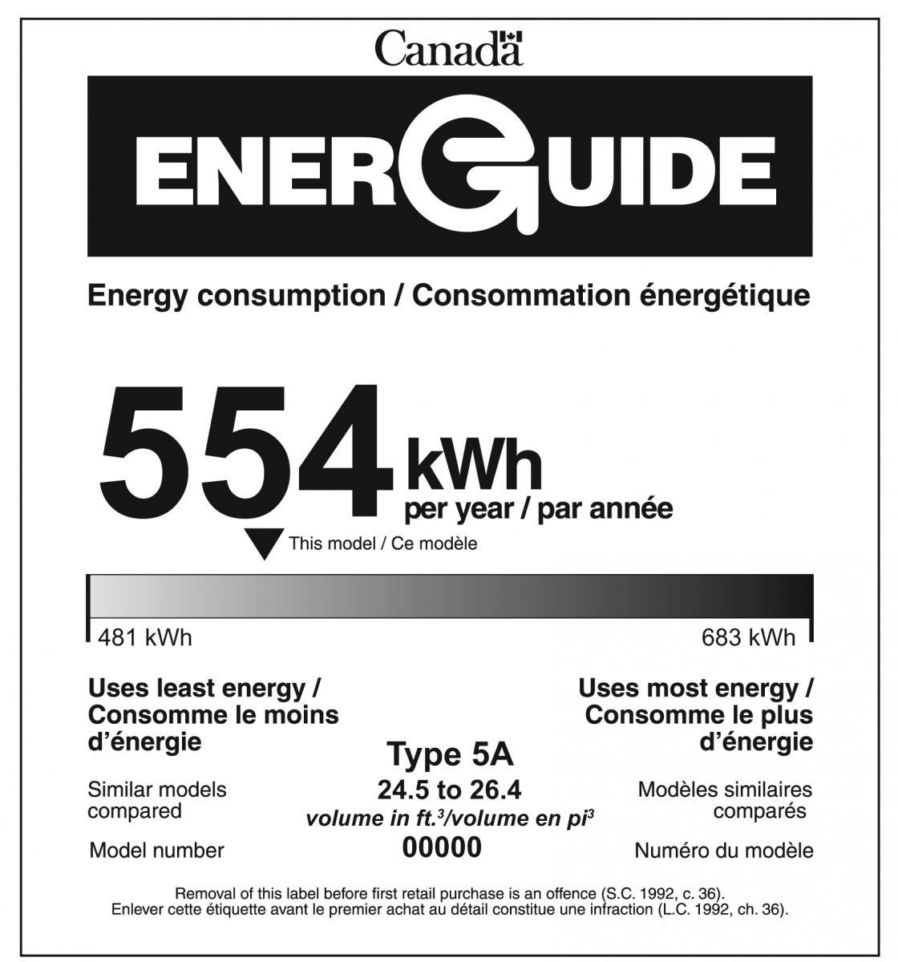
EnerGuide Labels
NOT A Certification
EnerGuide label shows how much energy a product uses and how that compares to similar models.
Annual energy consumption of the model in kilowatt hours ( kWh)
Energy consumption indicator, which positions the model compared with the most efficient and least efficient models in the same class
Type and capacity of models that make up this class
The model number
Notes:
The EnerGuide label is mandatory for:
clothes dryers
clothes washers (including integrated washer-dryers)
dishwashers
freezers
electric ranges, cooktops and ovens
refrigerators, refrigerator-freezers and wine chillers
room air conditioners
The EnerGuide label is voluntary for:
central air conditioners
furnaces (oil-, gas- or propane-fired)
heat pumps—air source
gas fireplaces
water heaters
Often products (such as appliances and room air conditioners), that are regulated and carry the EnerGuide label are also ENERGY STAR certified models. In these cases, the ENERGY STAR symbol will appear at the bottom of the EnerGuide label.

Slide 39

Electronic Products Environmental Assessment Tool (EPEAT®)
Comprehensive environmental rating system that helps identify electronic products that meet a wide range of energy efficiency and other environmental criteria.
The US based EPEAT system was conceived and developed through the collaboration of stakeholders from the business, advocacy, government and academic arenas.
EPEAT’s website contains a searchable Registry that allows users to search by level (Gold, Silver or Bronze) and by individual criteria.
The Green Electronics Council (GEC) manages this flagship program, including ensuring the integrity of the EPEAT system.

Slide 40
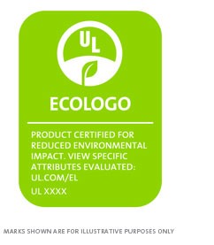
Eco Logo
ECOLOGO Certified products, services and packaging are certified for reduced environmental impact.
ECOLOGO Certifications are voluntary, multi-attribute, lifecycle based environmental certifications that indicate a product has undergone rigorous scientific testing, exhaustive auditing, or both, to prove its compliance with stringent, third-party, environmental performance standards.
Products include: building materials, flooring, chemical and Plastics; Cleaning & Personal Care Products; Office Products; Renewable Energy, GHG neutral, events, etc..

Slide 41

Green Seal
Non-profit organization (US based) that uses life-cycle based sustainability standards to certify products, services and companies.
Products include: household products; construction materials; paints & coatings; paper products; food packaging; cleaning products & services; restaurant and food services.

Slide 42

RoHS-Compliant
Restriction of Hazardous Substances (RoHS) Directive is a regulation adopted by the European Union that restricts certain hazardous materials in electrical equipment (including appliances) sold in the EU marketplace.
The restricted materials include highly toxic heavy metals (e.g., lead, cadmium, hexavalent chromium and mercury) and flame retardants (e.g., polybrominated diphenyl ethers and polybrominated biphenyls).
There is no official RoHS-compliant eco-label, although the EU does spot check product to prevent false claims.

Slide 43

Biodegradable Products Institute (BPI)
Certifier of compostable products and packaging.
Ensures that products and packaging displaying the BPI logo have been independently tested and verified.
Promote best practices for the diversion and recovery of compostable materials through municipal and commercial composting.

Slide 44

Cradle to Cradle
Guides designers and manufacturers through a continual improvement process that looks at a product through five quality categories — material health, material reutilization, renewable energy and carbon management, water stewardship, and social fairness.
A product receives an achievement level in each category — Basic, Bronze, Silver, Gold, or Platinum — with the lowest achievement level representing the product’s overall mark.
Product assessments are performed by a qualified independent organization trained by the Institute.
Assessment Summary Reports are reviewed by the Institute, which certifies products meeting the Standard requirements, and licenses the use of the Cradle to Cradle Certified™ word and design marks to the product manufacturer.
Every two years, manufacturers must demonstrate good faith efforts to improve their products in order to have their products recertified.

Slide 45

Forest Stewardship Council (FSC)
A voluntary, market-based program that supports environmentally responsible forest management worldwide.
FSC-certified forest products are verified from the forest of origin through the supply chain.
Ensures that the forest products (including end-products such as wood flooring) used are from responsibly harvested and verified sources.

Slide 46

Sustainable Forestry Initiative (SFI)
Criteria promotes sustainable forest management, including measures to protect water quality, biodiversity, wildlife habitat, species at risk, and Forests with Exceptional Conservation Value.
SFI forest certification promotes responsible forestry practices. SFI chain-of-custody certification is an accounting system that tracks fiber content through production and manufacturing to the end product.
Fiber sourcing certification addresses the fact that all forest landowners play a critical role in the long-term health and sustainability of forest – and that 90 percent of the world’s forests are not certified.

Slide 47

Chlorine Free Products Association (CFPA)
The Chlorine Free Products Association (CFPA) is an independent not-for-profit accreditation and standard setting organization focused on promoting practices free of chlorine chemistry.
Two certifications are offered for products, Totally Chlorine Free (TCF) and Processed Chlorine Free (PCF).

Slide 48

Design for the Environment
Design for the Environment (DfE) developed several different programs and tools to help its stakeholders evaluate human health and environmental attributes of chemicals in products.
A complete listing of all recent DfE reports and publications is available.
DfE Alternatives Assessments
DfE Life Cycle Assessments
DfE Pilot Projects
DfE Workplaces

Slide 49

Biodegradable Products Institute (BPI)
North America’s leading certifier of compostable products and packaging.
Ensures that products and packaging displaying the BPI logo have been independently tested and verified according to scientifically based standards.
Promotes best practices for the diversion and recovery of compostable materials through municipal and commercial composting.

Slide 50

GREENGUARD
An Indoor Air Quality Certification Program certifies products designed for use in office environments and other indoor spaces meet strict chemical emissions limits, which can contribute to the creation of healthier interiors.
Considered as a single-attribute certification as it only evaluates products for their chemical emissions and no other environmental attributes that may be of significance.
Therefore, it should be used only for paints and coating products that don’t have stronger multi-attribute certifications by Green Seal or EcoLogo.
Has two levels of product certifications: indoor air quality generally and a more stringent certification recommended for Children and Schools.

Slide 51

WaterSense
Offers consumers a simple way to use less water by choosing water-efficient products.
Products identified as WaterSense-certified meet water efficiency standards and will generally consume less water than standard products.
Certified products include faucets, toilets, flushing urinals, showerheads, and irrigation controllers.
Note: Most WaterSense products are designed to meet residential building codes, so they can usually be specified for small housing units but not large commercial buildings.

Slide 52




Other Possible Certifications
NoBlue Angel (Germany)
European Union Ecolabel
Nordic Swan Label (Scandanavia)
Missing Certifications???

Slide 53
How to Avoid Falling for Greenwashing

Slide 54
Risks of Greenwashing
Consumers are misled and lose trust regarding environmental benefits
Illegitimate claims take market share away from products that provide real environmental innovation
Leads to cynicism and doubt about all environmental claims. Consumer more likely to give up on finding the environmentally preferred choice
Sustainability movement loses the power of the market to accelerate progress towards sustainability.

Slide 55
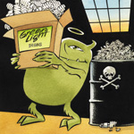
Sin of the Hidden Trade-Off
A claim suggesting that a product is ‘green’ based on a narrow set of attributes without attention to other important environmental issues.
Paper, for example, is not necessarily environmentally-preferable just because it comes from a sustainably-harvested forest. Other important environmental issues in the paper-making process, such as greenhouse gas emissions, or chlorine use in bleaching may be equally important.

Slide 56

Sin of No-Proof
An environmental claim that cannot be substantiated by easily accessible supporting information or by a reliable third-party certification.
Common examples are facial tissues or toilet tissue products that claim various percentages of post-consumer recycled content without providing evidence.

Slide 57

Sin of Vagueness
A claim that is so poorly defined or broad that its real meaning is likely to be misunderstood by the consumer.
‘All-natural’ is an example. Arsenic, uranium, mercury, and formaldehyde are all naturally occurring, and poisonous.
‘All natural’ isn’t necessarily ‘green’.

Slide 58

Sin of Worshipping False Labels
A product that, through either words or images, gives the impression of third-party endorsement where no such endorsement exists.
Companies make up fake labels in other words.

Slide 59

Sin of Irrelevance
An environmental claim that may be truthful but is unimportant or unhelpful for consumers seeking environmentally preferable products. ‘CFC-free’ is a common example, since it is a frequent claim despite the fact that CFCs are banned by law.

Slide 60

Sin of Lesser of Two Evils
A claim that may be true within the product category, but that risks distracting the consumer from the greater environmental impacts of the category as a whole.
Organic cigarettes could be an example of this Sin, as might the fuel-efficient sport-utility vehicle.

Slide 61

Sin of Fibbing
Environmental claims that are simply false.
The most common examples were products falsely claiming to be Energy Star certified but they lie, they lie!!!

Slide 62
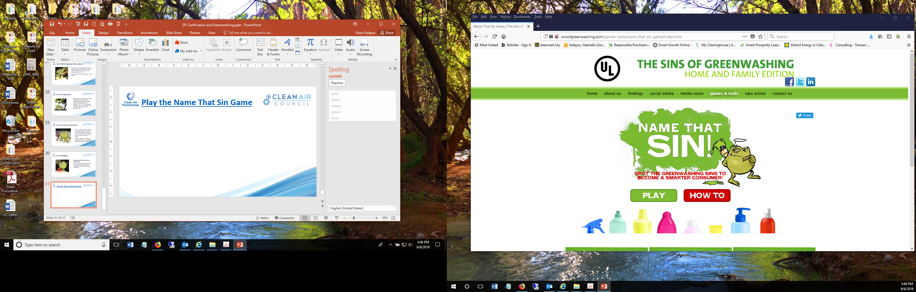
Play the Name That Sin Game

Slide 63
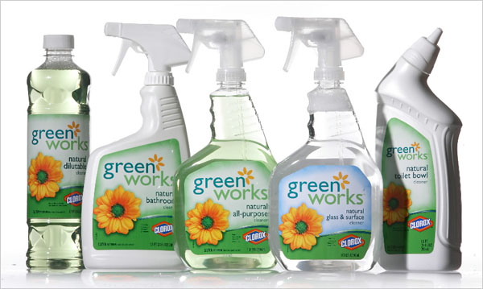

Slide 64


Slide 65


Slide 66
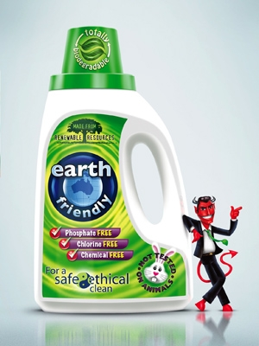

Slide 67
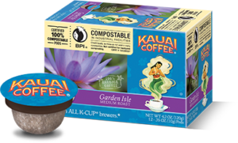

Slide 68
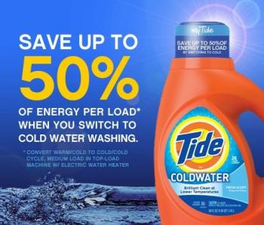

Slide 69
Green Procurement In ACTION!!!
Part C

Slide 70
Green Procurement in Action – Electronics
Form a green electronics procurement team to develop and implement procurement, operational, and end-of-life waste management strategies for electronics
Create either a stand-alone green electronics policy or incorporate green electronics procurement language into existing sustainable procurement policies or broader sustainability policies
Developing a green electronics procurement implementation plan, clearly identify important steps your jurisdiction intends to take to make meaningful progress toward meeting its policy goals
Assess your current green electronics purchasing practices, including reviewing existing contracts to identify upcoming sustainable procurement opportunities; identifying renewal/bid dates and how contracts are developed (e.g., RFP, ITB, etc.); and conducting a spend analysis to determine volumes of both conventional and green electronics purchased

Slide 71
Electronics In Action (cont…)
Adopt green electronics specifications and procedures that require compliance with sustainability specifications or standards (e.g., EPEAT/ENERGY STAR), or award points in the RFP process to vendors that offer more certified products, or products certified at a higher level
Address end-of-life management in your contracts including erasing data from equipment, donating usable equipment, using end-of-life services provided by vendors or manufacturers, and requiring vendors to track and report equipment’s final destination
Establish a paper reduction policy and procurement practices to save money and reduce waste
Purchase ancillary IT products that offer environmental, health, and economic benefits such as toner and ink cartridges, power supplies, thumb drives and other storage devices, batteries, and other products that are needed to operate electronics
Track and report results by calculating the dollar amount and percentage of electronics that meet environmental specifications (e.g., EPEAT/ENERGY STAR).

Slide 72
Electronics still in Action
Electronic Product Environmental Assessment Tool (EPEAT) makes it easy for purchasers to evaluate, compare, and select desktops, notebooks, monitors, and imaging equipment based on their environmental attributes.
EPEAT certification includes three increasingly stringent tiers of environmental performance: Bronze, Silver, and Gold.
The ENERGY STAR standard for energy efficient computers, is a required criterion in the EPEAT computer standard.
EPEAT, which is managed by the Green Electronics Council, has a wealth of information for purchasers available on its website, including plug-and-play contract language, best practice guides, and too for calculating benefits attributable to EPEAT purchasing.

Slide 73
Electronics in Action
Using certified recyclers can help ensure your electronics are properly managed at their end of life.
Eliminating desktop printers and investing in multi-function devices (MFDs) that combine the tasks of printers, copiers, fax machines, and scanners into once machine can significantly lower costs for hardware, consumables (paper, ink and toner), electricity, and maintenance.
Education on screen/computer shout down/ working with IT on shut down options.

Slide 74
Green Procurement in Action – Fleets
Create a sustainable fleet team, policy, and detailed implementation plan
Conduct a baseline assessment of the municipal fleet to identify vehicles that are targets for retirement because they are relatively old or polluting
Downsize the fleet and using car-sharing services to optimize the remaining vehicles
Purchasing replacement vehicles with high fuel efficiency and low emissions including hybrids and electric vehicles
Build an alternative fuel infrastructure for use by employees (and possibly members of the community)
Pursue strategies to reduce the upfront costs of sustainable fleet vehicles and infrastructure (e.g., cooperative purchasing, reverse auctions, and grants)
Notes:
A reverse auction is a type of auction in which the roles of buyer and seller are reversed. In an ordinary auction (also known as a 'forward auction'), buyers compete to obtain goods or services by offering increasingly higher prices. In a reverse auction, the sellers compete to obtain business from the buyer and prices will typically decrease as the sellers underbid each other.

Slide 75
Fleets Still in Action
Reduce diesel use and emissions by purchasing electric and hybrid heavy-duty vehicles, “renewable” fuel, and biodiesel
Purchase equipment to reduce fuel use (e.g., GPS to optimize routes, telematics to track vehicle usage and driving behavior, anti-idling equipment, and telecommunications equipment to enable employees to meet remotely rather than drive to meetings)
Add bicycles (and bike-sharing services) to the fleet
Encourage contractors to use sustainable fleet vehicles when delivering products or performing services for your municipality
Purchase environmentally preferable fleet maintenance products (e.g., re-refined motor oil, retread and low-rolling-resistance tires, copper-free brake pads, mercury-free lights, lead-free wheel weights, and certified low-toxicity cleaners and degreasers)
Car-sharing services cost significantly less per mile than owning an operating a fleet vehicle because it eliminates maintenance, repair, parking, and insurance costs

Slide 76
Green Procurement in Action – Greening Buildings
Create an effective green building team that engages purchasing agents; members of your sustainability team; staff from infrastructure planning, design, and engineering groups, facility maintenance staff
Adopt a green purchasing policy for municipal building supplies
Conduct an assessment of your jurisdiction’s procurement practices for building equipment and supplies
Conduct a baseline assessment of your jurisdiction’s current building supplies to identify strategic opportunities where sustainable purchasing practices can make a difference

Slide 77
Greening Buildings Still in Action
Develop a green building supplies procurement plan to align your jurisdiction’s procurement practices with existing government sustainability goals, such as reducing waste, energy consumption or GHG emissions
Identify upcoming contract opportunities for green building products and services
Develop sustainability specifications and contracting strategies for high-spend/high-impact building materials, equipment, and supplies
Negotiate discounts for sustainable building materials, equipment, and supplies
Vendor training for facility staff

Slide 78
Cost Savings
The City of Boston, MA, which has replaced most of its mercury vapor street lights with LEDs,reported that this sustainable procurement initiative is saving the City $4.25 million annually in lower utility bills and conserving enough electricity to power 4000 homes.
King County, WA saved more than $200,000 over a three-year period by purchasing copiers that can easily email documents and make two sided copies, which enabled it to cut its copy paper usage 20%. Also saves over $500,000 every year by using remanufactured toner cartridges and supports local business by doing so.
The City of Portland, OR lowered its trash and janitorial service fees by $1500/month by replacing paper towel dispensers with high-efficiency hand dryers in several buildings.
The City of Palo Alto reported that having a green purchasing policy in place enabled them to qualify for, and subsequently receive, a $250,000 grant from the State of California.
Alameda County, CA undertook a countywide interior lighting retrofit that reduced its annual energy use by 3 million kWh, saving $350,000 and shrinking its carbon footprint by 1.6 million pounds.

Slide 79
San Francisco, Green Cleaning
The City of San Francisco has implemented a green cleaning program to protect employees and users with its Precautionary Purchasing Policy. The City specified and procured a wide array of certified low-toxicity cleaning products, hand soaps, and building maintenance chemicals. To support this program, the City also:
Created a series of green cleaning training videos that have been provided to the City’s custodial staff as well as to numerous janitorial service companies in San Francisco;
Commissioned RPN and the Pesticide Research Institute to conduct a report on Safer Products and Practices for Disinfecting and Sanitizing Surfaces in order to identify healthier alternatives to bleach and other disinfectants that are known to contain chemicals that can cause asthma and other serious health hazards; and
Helped San Francisco Unified School District to pilot test and transition to using certified low-toxicity cleaners and asthma-safe disinfectants.

Slide 80
Supporting the Local Economy
The City of Edmonton, AB, Canada contributed 25% of the financing to create an innovative recycling facility that collects waste paper and linen (100% cotton materials) products from City offices, residents and hotels and achieves “closed--‐loop recycling” by processing it into recycled paper products for sale back to the City and other clients. At full capacity, 100 jobs were created at the facility.
More than 100 local companies are now providing paper and used cotton fabric (e.g., clothing and sheets) to the facility and have also committed to ‘joining the loop’ by purchasing products from Greys.
The City is receiving a share of the profits.

Slide 81
Managing Cost Concerns
When the City of Calgary, AB, Canada began to implement its Sustainable Environmental and Ethical Procurement Policy (SEEPP) and program, it began by piloting its new way of buying and, using the results of their pilots, prepared a cost impact summary table in its report to the City Council, in order to address concerns about potential cost increases from sustainable purchasing. The City found that, “the costs associated with the continued implementation of the policy appear to be minimal.
The team will continue to monitor costs on an ongoing basis and where there are significant increases or implications, they will be addressed on a case-by-case basis.”
Calgary’s evidence-based reporting approach resulted in obtaining Council approval for continuation of its policy.

Slide 82
Life-Cycle Costing
Palo Alto, California’s Environmentally Preferred Purchasing Policy provides that the evaluation of prices for goods and services “shall factor in life-cycle costs, total product cost over the lifetime of the product (use, maintenance, disposal), risk management, regulatory requirements and penalties for non-compliance.”
Denver, Colorado’s sustainability policy requires "assessing the total cost of ownership by including initial cost, operating costs, and disposal or end of life cost, with due consideration of leasing as an alternative to outright purchase."

Slide 83
Making GP the Default Procurement
Washington, DC’s procurement policy applies to most high-spend procurements. The City set a monetary threshold and carved out an exemption for its green procurement requirements that states, “Except for emergency procurements, before entering into any contract in excess of $100,000, the District shall issue an environmental certification to demonstrate, to the maximum extent practicable, the purchase of an EPPS [Environmentally Preferable Product or Service].”
Portland, Oregon’s Sustainable Procurement Policy requires all major procurement decisions to follow standards approved by its Chief Procurement Officer unless an exemption is granted. The policy states, “Upon request, exemptions to the sustainable procurement standards may be granted by the Chief Procurement Officer when product or service availability or other reasonable circumstances hinder compliance with the standards.”

Slide 84
Tracking and Reporting
Calgary, Alberta’s Sustainable and Ethical Procurement Policy requires each business unit within the City to “meet periodically with Finance and Supply to report on the progress of policy implementation, including: 1. The results of product evaluations and product trials; 2. The status of efforts to maximize sustainable purchasing; and 3. Total purchases of sustainable products and services.”
Santa Clara County, California’s Environmentally Preferable Purchasing Policy directs its EPP Team to “prepare and submit to the Board of Supervisors an annual report summarizing the implementation of the policy during the previous year; policy related goals for the following year; and recommended changes, if any, to the policy or its implementation.”

Slide 85
Tracking and Reporting (cont…)
Portland, Oregon’s Sustainable Procurement Policy includes a detailed section on “Data Collection and Performance Reporting,” which prescribes the roles and responsibilities of various City agencies in carrying out this program function. It specifically states: City Bureau Directors shall be responsible for: Cooperating in gathering information for the purposes of tracking, reporting, and evaluating the City’s sustainable procurement activities; and Integrating Bureau-specific sustainable procurement goals into Bureau sustainability plans.
The Chief Procurement Officer and Director of the Bureau of Planning and Sustainability shall be responsible for: Collaborating on data collection for the purpose of tracking and reporting on the City’s sustainable procurement activities and evaluating the effectiveness of this policy. The Chief Procurement Officer shall be responsible for: Issuing an annual or biennial progress report on sustainable procurement activities and the effectiveness of this policy. This report may be a stand-alone report or integrated into a larger Bureau of Procurement Services report.

Slide 86
Tracking and Reporting (cont…)
San Jose, California’s Environmentally Preferable Procurement Policy requires the following types of performance measurements to be made: quantification of “the environmental and economic benefits of the procurement of environmental alternatives such as recycled-content paper, biodiesel, and IT equipment by utilizing available product environmental benefits calculators.”
Seattle, Washington’s Sustainable Purchasing Policy directs City Purchasing to “compile records for producing an annual summary of the City’s environmentally responsible/ sustainable purchasing actions, and to evaluate the effectiveness in reducing the environmental impacts of City procurement.”

Slide 87
Policy Review and Update
Portland, Oregon’s Sustainable Procurement Policy directs the Chief Procurement Office to be “responsible for periodically bring[ing] together internal stakeholders to review this policy for updates or to otherwise determine whether this policy is in alignment with other City sustainability efforts and policies.”
Raleigh, North Carolina’s Sustainable Procurement Policy states: “The manager of the Purchasing Division shall be responsible for periodically bringing together internal stakeholders to review this policy for updates or to otherwise determine whether this policy is in alignment with other City sustainability efforts and policies. This policy review shall be completed at least every five years, but may be done on a more frequent basis as needed.”

Slide 88
Policy Review and Update
Vancouver, British Columbia’s Ethical Purchasing Policy specifies that: “The Manager of Materials Management will be responsible for reviewing the EPP [Ethical Purchasing Policy] and SCC [Supplier Code of Conduct] annually and reporting findings to Council annually.
Through consultations with key stakeholders (suppliers, subject experts, city staff, etc.) the Manager of Materials Management will identify and recommend revisions to the EPP and SCC.
Such review will include a review of new items for potential inclusion within the scope of the EPP (e.g., new fair trade certified agricultural products).”

Slide 89
Category Specific Procurement Policies
St. Louis, Missouri’s Executive Order #43 prohibits its “departments, divisions, and agencies [from] purchasing single-serving bottled water for employee consumption with City funds.”
Santa Clara County, California’s Green Cleaning Administrative Guidance states: “All cleaning products used within County-owned or operated facilities shall be certified by a nationally recognized, third party, certifying organization or the products must be approved by the procuring department as equal to the green certified products, unless green products are unavailable, not cost effective or not practicable.”

Slide 90
Category Specific Policies
San Francisco, California’s Approved Environmentally Preferable Purchasing Requirements for Personal Computers and Servers directs City departments to purchase personal computers, notebook computers, and monitors that meet the EPEAT Gold standard.
Eugene, Oregon’s Resolution No. 5101 prohibits the City of Eugene from using products that contain neonicotinoids on any City property, and calls for all departments within the City of Eugene to adopt an IPM policy and associated operational procedures.
Seattle, Washington’s Executive Order 01:05 Paper Waste Prevention directing City departments to: Reduce paper use by 30% by the end of 2006; Purchase 100% recycled paper as the City standard for printing and copying; Adopt available technology that will create paper efficiencies; Apply these paper waste prevention measures to procurement, consultant contracts, and contracts for printing, copying, and related services from outside vendors; and Include reporting of progress towards the 15% interim paper reduction goal in department accountability contracts.

Slide 91
Category Specific
Los Angeles, California’s Good Food Purchasing Pledge promotes the City’s procurement of local and sustainably produced food products.
Toronto, Ontario’s Purchase of Coffee, Tea and Sugar Policy directs divisions to include buy fair trade-certified products for purchasers greater than $3,000.
Cambridge, Massachusetts adopted an Energy Star Purchasing Policy requiring all new equipment purchased for City operations to be ENERGY STAR-certified or meet equivalent standards: “As the City replaces older equipment, new Energy Star equipment will reduce the energy load in City buildings.”
Houston, Texas’ City Energy Efficiency Policy, states: “All equipment, appliance and computer purchases should be Energy Star rated.

Slide 92
Category Specific
St. Louis, Missouri adopted a Sweatshop Free Procurement Policy that requires vendors to “complete a procurement disclosure form documenting the location of the factory where the items purchased by the City will be manufactured, the minimum base hourly wage of the employees employed by the factory, working hours of factory employees, benefits provided to factory employees and whether the factory is under investigation for any violation of State, Federal or local laws.”51 Additional sweatshop-free purchasing policies adopted by local governments (e.g., Austin, Texas; Berkeley, Los Angeles, and San Francisco, CA; Ithaca, NY; Madison, WI; Portland, OR; Seattle, WA; and Santa Fe, NM) are available on a website maintained by the Sweatfree Purchasing Consortium.

Slide 93
Green Procurement Staffing
The District of Columbia has a Sustainable Purchasing Program Manager in its Office of Contracting and Procurement. Similarly, Portland, Oregon’s Sustainable Procurement Coordinator is positioned in the City’s Procurement Services Department.
King County, Washington, has maintained at least one full-time staff person within its Procurement and Contract Services Department to coordinate its Environmental Purchasing Program for more than a decade. The County has been able to demonstrate that the activities of these individuals more than pay for the cost of having them on staff.

Slide 94
Green Procurement Staffing
San Francisco’s sustainable procurement program is staffed by several employees that work for its Department of the Environment (SFE) and have specific subject matter expertise. SFE staff coordinate with various buyers in its Office of Contract Administration to identify and pursue sustainable procurement opportunities, and to quantify the effectiveness of its sustainable purchasing program in an annual report to the County Board of Supervisors.
Edmonton has one fulltime dedicated staff person to oversee the implementation of its sustainable procurement policy and program.

Slide 95
Green Procurement Resources
Minneapolis, Minnesota, for instance, has a Lead by Example Fund that has helped its departments offset the cost associated with pilot testing and purchasing green cleaning supplies and other sustainable goods and services.
The City of Ottawa, Ontario, published a Sustainable Purchasing Guideline and accompanying Toolkit in 2013. These documents lay out definitions, responsibilities for Supply Branch employees as well as other Managers and staff involved in purchasing, and steps to follow. The Toolkit uses worksheets, checklists, and questionnaires to guide purchasing professionals at the City through a sustainability assessment of the prospective supplier (including a Total Cost of Ownership calculation), the inclusion of sustainability criteria and questions in bid solicitation documents, and the evaluation and rating of bids on a sustainability basis.

Slide 96
April 2011, Metro Vancouver, British Columbia, published a set of Sustainable Procurement and Green Procurement Procedures59, to help promote consistency in the Region.
The City of Calgary, Alberta has undertaken Supplier Code of Conduct Their questionnaire is a mixture of yes/no and open-ended questions, along with requirements to provide verifiable evidence for most affirmative responses. These documents complement the mandatory or desirable product-specific standards that are inserted into bid solicitations, and provide a more complete picture of the sustainability impacts of a particular procurement.

Slide 97
Training
Vancouver, Trained Employees to Use Its Sustainable Procurement Tools. Ran two training sessions for each of the teams in their Supply Chain department to educate them on how to effectively use the updated set of sustainable procurement tools that were developed by the City. This ensured initial familiarity by staff and resulting in better uptake and proper utilization of the tools.
City of Edmonton, sustainable purchasing training activities focused on administrative staff, who make spot purchases and order supplies.
The City of Edmonton, Alberta worked with its office supplies vendor to ensure that, whenever a given product is searched for in their ordering database, an environmentally preferable alternative automatically shows up as a suggestion.
Educating staff in a voluntary program is time consuming and costly. Many municipalities have made mandatory requirements (ex. recycled content, third party certification, Energy Star, ect..).

Slide 98
Training
Training and education still plays a large role both internally and externally. First, to ensure that those who are developing bid solicitations and crafting contracts understand when and how to meaningfully consider sustainability.
Second, that vendors are aware of the jurisdiction’s sustainability goals and considerations and resources so that they can become partners in sustainable purchasing activities.
Municipalities that are considered leaders in sustainable procurement also develop and maintain an up to-date sustainable procurement website for employees to use as a reference when making purchasing decisions and for vendors to use when responding to bid solicitations.

Slide 99
Buying Local Challenges
Many municipalities, particularly in Canada, are deterred from adopting policies that specify or give preference to local companies by the potential legal restrictions arising from trade agreements. Examples of trade agreements that affect Canadian purchasing include: the Agreement on Internal Trade, the New West Partnership Agreement, and the Comprehensive Economic and Trade Agreement.
If your jurisdiction is hesitant to formally call out local preferences in requests for proposal or tenders, informing local suppliers of opportunities and encouraging them to apply to your jurisdiction’s bid requests can go a long way toward receiving competitive proposals from these businesses, which may then be organically selected above their competitors.

Slide 100
Green Cleaning
Santa Clara County, California incorporated a Green Cleaning Policy into its Policies of Sustainability. It states: “All cleaning products used within County--‐owned or operated facilities shall be certified by a nationally--‐recognized, third--‐party, certifying organization or the products must be approved by the procuring department as equal to the green--‐certified products, unless green products are unavailable, not cost--‐effective or not practicable.”
Town of Aurora renegotiated the service contracts for all Town facilities committing cleaning contractors to use green products and practices. This service was offered in the running of the contract and did not cost anymore. The Town is planning to promote the use of green products to staff by putting stickers on mirrors.

Slide 101
Green Cleaning
City of Brampton Cleaning products are required to be Green Seal certified, paper products are 100% recycled; hand and body soaps are Ecologo certified. IT has engaged a 3rd party for environmentally responsible disposal of PCs and servers. All computers are Energy Star and every computer has a power down sticker on it.
City of Mississauga requires recycled products under the Ecologo certification for all janitorial paper products at all facilities.

Slide 102
Food
The City of Edmonton, Alberta’s Purchasing Department created out a Sustainable Catering Guide, to help administrative staff make more sustainable catering choices. To create the guide, Procurement surveyed 80-90 catering companies on all manners of sustainability concerns, receiving 55 responses. The guide was created with green leaves for each category in which the companies had some sustainability practices. It also included a checklist for after the company was chosen, to help staff to order more sustainable options from the menu.
Town of Oakville food services cafeteria stopped selling bottled water, only uses compostable take away packaging and uses only fair trade coffee.

Slide 103
Life Cycle Costing
Town of Caledon Energy Star referenced in all electronic RFPs. Life cycle costing is used for all cost calculations.
The City of Hamilton has a life cycle costing requirement in all purchasing decisions.
Region of Peel has a Lifecycle Cost Policy and Calculator; requires Energy Star for all social housing.
Town of Newmarket has a Green Fund in place used to cover potential additional costs for green products.

Slide 104
Providing council reports digitally seems to be becoming the norm….
Recycled paper policy in place in Markham (100% post consumer waste – with a minimum requirement of 85%). Outside printing needs to be FSC certified. All attributes are to be stated on printed materials.
Town of Oakville has a green procurement policy, procedure, one stop web site, training, worked with supplier to augment green product profile, third party Ecologo certification the norm; all office furniture is donated for reuse.

Slide 105
City of Oshawa has a green cleaning strategy that requires Green Seal or equivalent certification. Scent free workplace. Energy Star certification required for computers.
City of Pickering requires FSC 100% recycled content paper.
Town of Whitby procures green cleaning products through Swish and have installed auto awake system on computers to allow for staff to power down while not limiting software upgrades and IT maintenance. Computers are all Energy Star compliant and meet EPEAT Gold rating.

Slide 106
Whistler, BC requires 3rd part certified eco labels and is a green product or service is not available the send a message to the supplier letting them know what they are looking for. Making advancements in the monitoring and reporting area.
The City of Ottawa has undertaken a supplier Code of Conduct.

