Slide 1
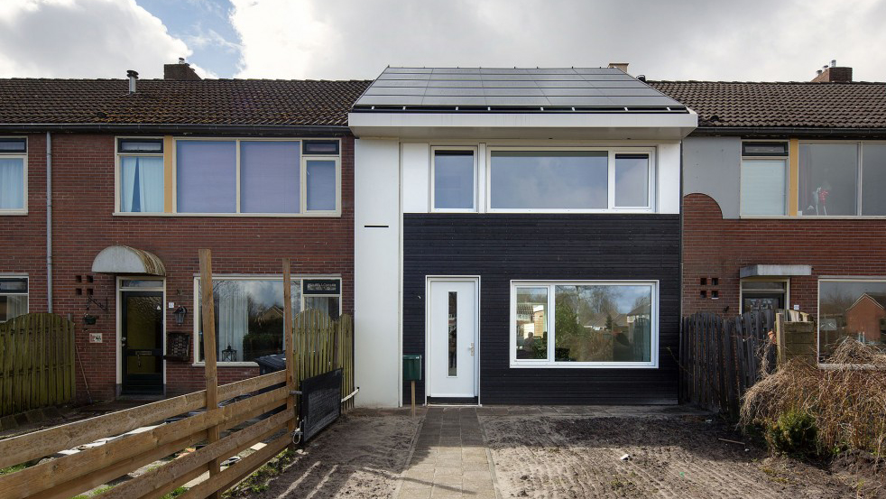


Energiesprong Canada – a market transformation strategy
ACCELERATING NET-ZERO SOCIAL HOUSING RETROFITS

Slide 2


Big Ideas are Needed
“The difficulty lies, not in the new ideas, but in escaping from the old ones.”
John Maynard Keynes
At our current pace of building improvement , we will not reach our 2030 or 2050 greenhouse gas reduction targets.
Between now and 2050 most buildings will only have the opportunity for one or two retrofits.
Piecemeal upgrades won’t get us to the goal – whole building solutions are needed.

Slide 3


Slide 4
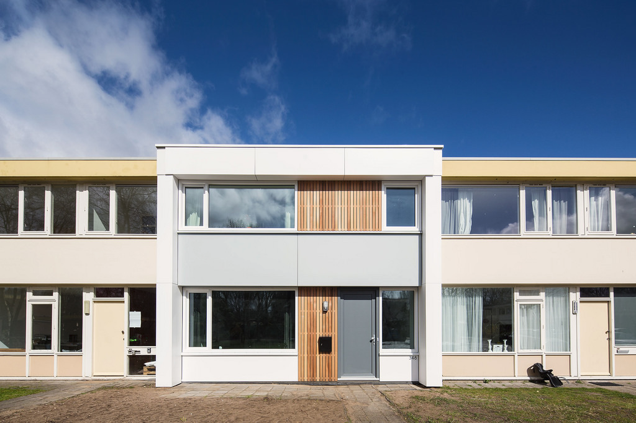
Energiesprong offers a market transformation strategy to stimulate investment and innovation in whole home retrofits, and zero energy housing

Slide 5








Slide 6
In the market transformed, desirable, warm and affordable homes for life.
Net-Zero
Affordable
Quality
Full retrofit in 1 week to 10 days
Fully financeable off avoided energy and maintenance costs
Improved performance and design guaranteed for 30 years
Designed to eliminate monthly energy bills
Non-Intrusive

Slide 7
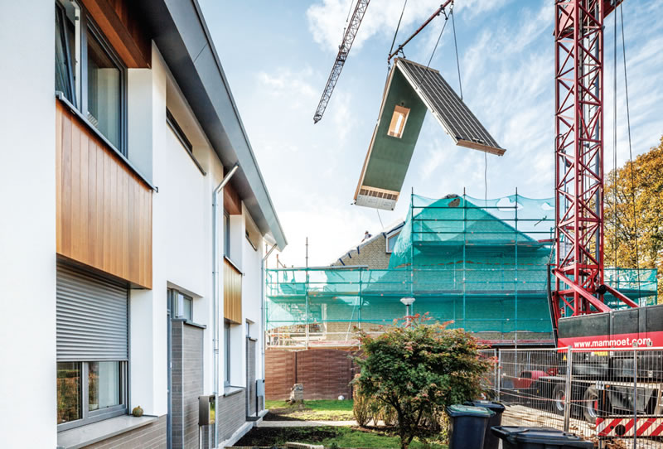
SBC Research Phase
Board approval - Sept 2016
Engaged Energiesprong International
Netherlands site visits
ONPHA outreach and size of National and Provincial Markets
Design and Policy Workshops in Toronto and Ottawa
Produced and Published reports and recommendations – Sept 2017
Partnered with NRCan CANMET for cladding
research
Conclusions?

Slide 8
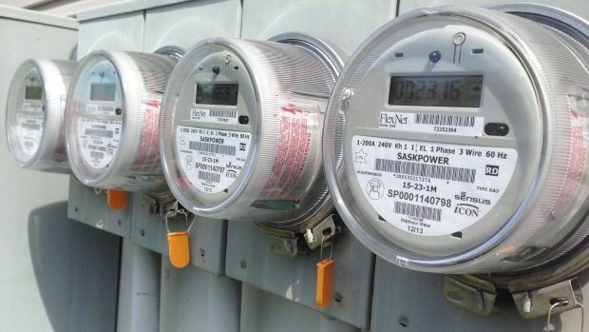
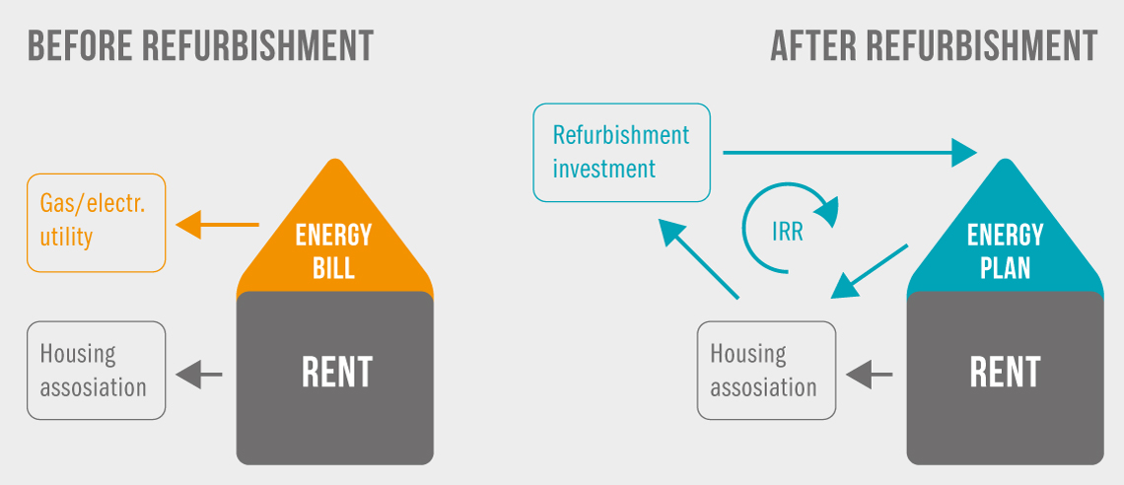
1. Investing in Net-Zero
Energy performance guarantees can be given on a net-zero energy refurbishment more easily than incremental improvements.
The home after the retrofit is as good or better than a new home, so the investment can be amortized over a longer period of time.

Slide 9
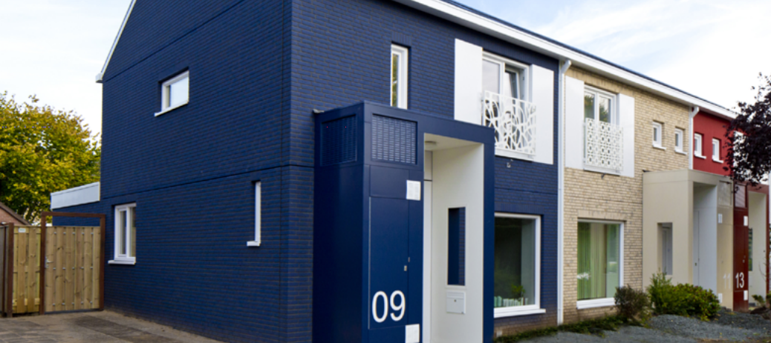
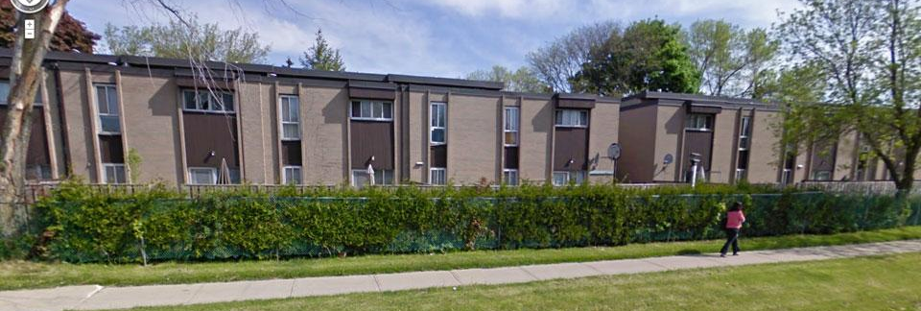
2. The right type of housing
The European model of retrofitting low-rise townhomes is well suited to the Canadian context.
Ontario has many similarly designed dwellings, many of which are expensive to operate and in need of repair.
The size and nature of these structures make them ideal from both a technology and construction perspective.
However…climate and basements present challenges to the financial model in Canada

Slide 10
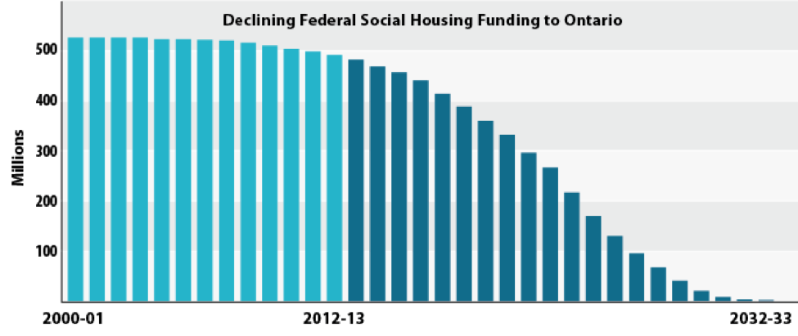
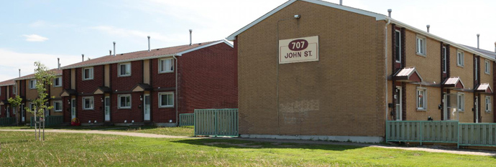
3. Social housing can lead
Reaching initial economies of scale is critical to success and social housing offers a volume of dwellings not achievable in the private market.
Once the approach has been successfully demonstrated, it can easily roll out to the private sector through private or public financing.

Slide 11
Size of the Ontario Social Housing Market - Top Eight
Housing Provider | Part 9 Attached | Low Rise 1-4 MURB | Mid Rise 5-7 MURB | Hi Rise 8+ Murb | Detached Singles / Other | Provider Total
Toronto | 10592 | 2353 | 7650 | 37072 | 1765 | 58,845
York | 633 |  |  |  | 89 | 2441
Ottawa | 5400 | 9450 |  |  | 150 | 15000
Hamilton | 696 |  |  |  |  | 6000
Peel | 1200 | 6457 |  |  |  | 7657
Windsor | 1579 |  |  |  |  | 4708
Niagara | 376 |  |  |  |  | 2757
Ontario Aboriginal | TBC |  |  |  |  | TBC
Total | 21334 * |  |  |  |  | 100,690
* Current committed Providers exceed 25,000 rowhouse units

Slide 12
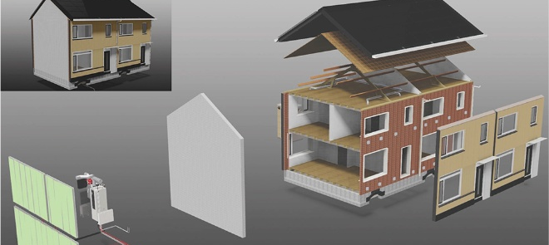
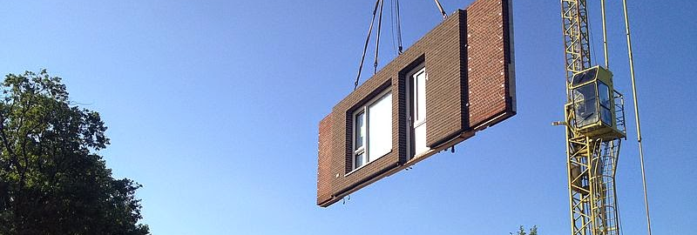
4. Breaking through business as usual
Construction innovations, including 3d scanning, BIM, pre-fabrication and modular construction enable whole building retrofits that are faster, higher quality, and less disruptive than the current approach in Ontario.

Slide 13


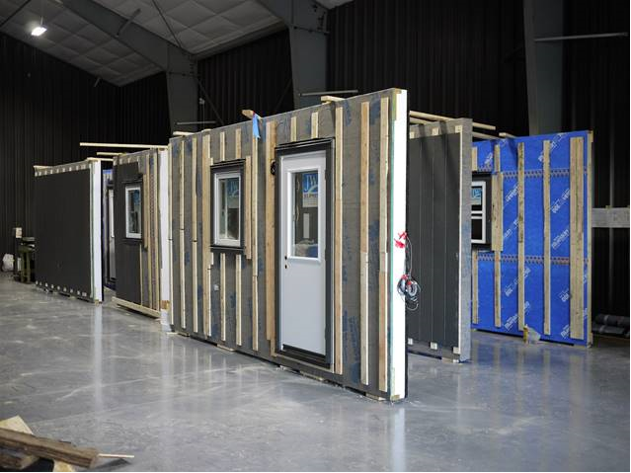
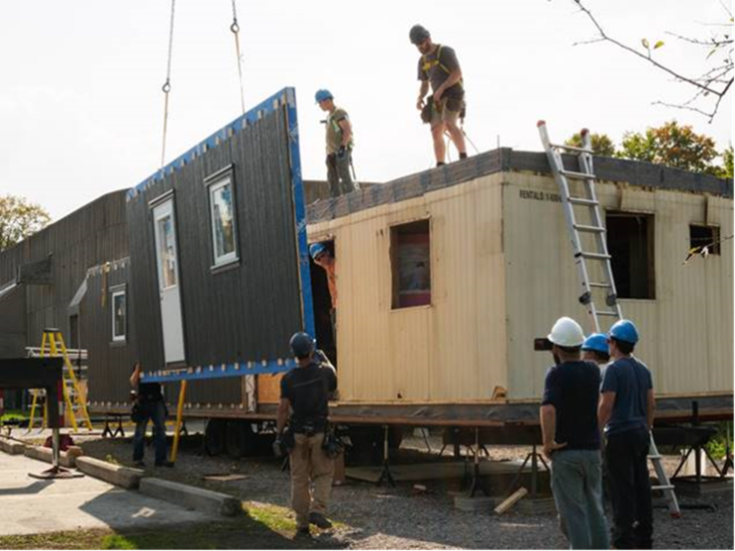
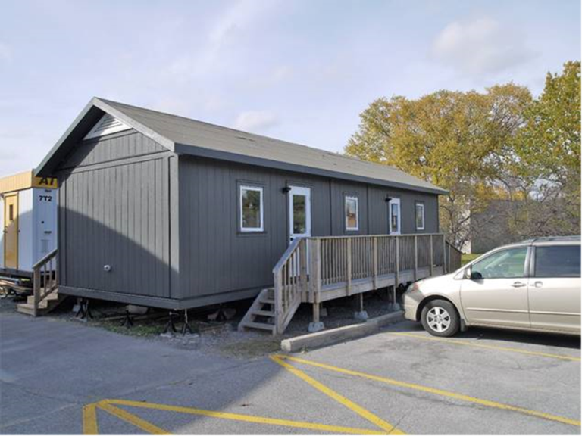
5. Capacity in Canada
Construction innovations, including 3d scanning, BIM, pre-fabrication and modular construction enable whole building retrofits that are faster, higher quality, and less disruptive than the current approach in Ontario.

Slide 14
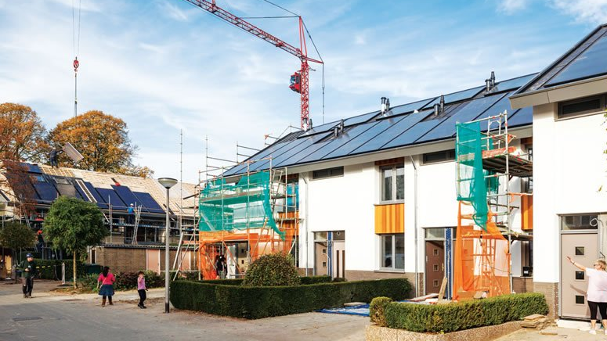
IMPACTS
Guaranteed comfort and improved tenant satisfaction
Ensures state of good repair through performance guarantees
Free’s up capital dollars for other priority investments
Community revitalization and sense of place
Drives private sector innovation in construction and technology development
Creates jobs in design, construction, and manufacturing
Provides investors with a dependable return on investment and
Reduces energy use and GHG emissions
PHOTO: https://passivehouseplus.ie/magazine/insight/energiesprong

Slide 15
Funding Phase
Market Development Team funding proposal to MOECC
Refurbishment of 5000 unit capital proposal to MHO
Design competition and pilot funding expression of Interest to NRCan Green Infrastructure Phase 2
1st prototype funding proposal in process to Municipal Infrastructure Fund with Durham Region

Slide 16
ONTARIO’S FIVE YEAR CLIMATE CHANGE ACTION PLAN - 2016 - 2020
Action Area: Buildings and Homes – Green House Gas Reduction Account (GGRA)
 | Action | Intended GGRA Funding | Est. GHG Reduction In 2020* |  | Est. Cost Per Tonne | Timetable: Action Start
1 | Improve energy efficiency in multi-tenant residential buildings
1.1 | Retrofit social housing apartments: Most of Ontario’s social housing towers were constructed in the 1960s and 1970s and can use up to 25 per cent more energy per square meter than a house. | $380,000,000 to $500,000,000 |  |  |  | 2017/18
1.2 | Protecting tenants from the price of carbon: Ontario will consider options for legislative and/ or regulatory change that lessen the impact on residential tenants of increased energy costs from cap and trade. | — |  |  |  | 2017/18
1.3 | Provide incentives for apartment building retrofits: Ontario will offer incentives to install energy efficient technologies, like boiler replacements, adaptive thermostats and lighting retrofits in multitenant buildings, such as apartments. | 1.3 $300,000,000 to $400,000,00 |  |  |  | 2017
Intended GGRA Funding (Total) |  | $680,000,000 to $900,000,000 |  | 99,000 Tonnes

Slide 17

“An Inclusive National Housing Strategy”
“As part of a new National Housing Strategy, the Government will invest more than $11.2 billion in a range of initiatives designed to build, renew and repair Canada’s stock of affordable housing and help to ensure that Canadians have adequate and affordable housing that meets their needs. This includes $225 million to improve housing conditions for Indigenous Peoples not living on-reserve.”
$2 billion is committed to refurbishment

Slide 18
Roosendall 2010
2 weeks
130,000 euro
Kirkrad 2011
10 days
100,000 euro
Appeldoorn 2012
1 week
80,000 euro
Arnhem 2014
1 day
60,000 euro
40,000 euro
Target Price

Slide 20
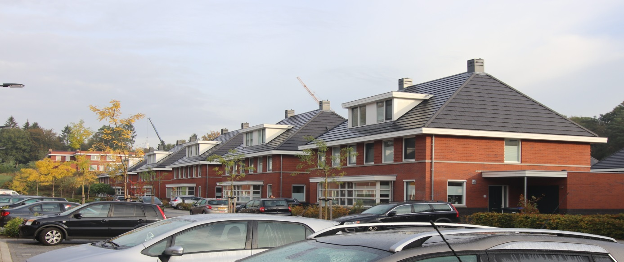
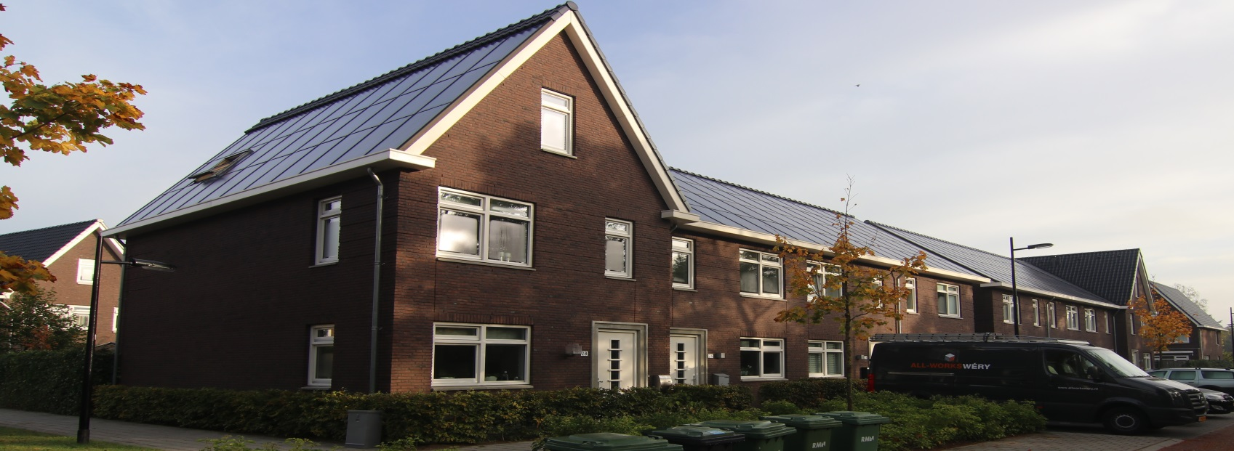
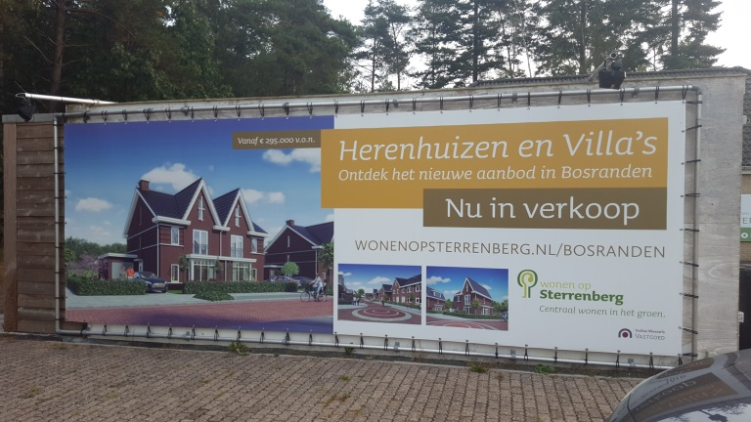
New Housing… Same innovation
Create the Demand – Assemble a portfolio of interested Social Housing and Co-op Housing Participants – 100,000 + Units
Research and Build the Capacity – Assemble a qualified and motivated group of Industry leading thinkers in Design and Construction interested in developing the solution – Performance based contracts with 30 year guarantees.
Engage the Finance Community – Net Present Value of 30 year avoided utility costs to capitalize the retrofit – Revenue stream backstopped by Ontario CCAP Green Bank
As the economies of scale have driven down the cost of the refurbishment, getting closer to the target price with each property, Constructors have applied their innovative industrialization approach to their existing businesses, building new, affordable zero energy housing for both the Social Housing and new home markets.

Slide 21

Can it be done in a day…? Yes it can!
Click here to view video

Slide 22
ENERGIESPRONG CANADA
Sustainable Buildings Canada
www.sbcanada.org
Research Reports
www.sbcanada.org/energiesprong
Larry Brydon, Director
416-704-0747
lbrydon@sbcanada.org

